Slide 1

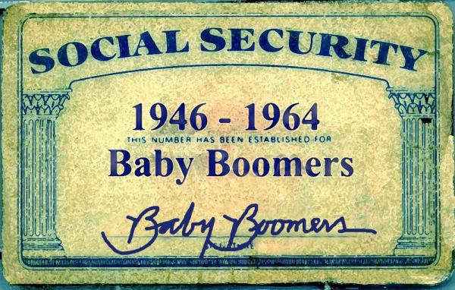

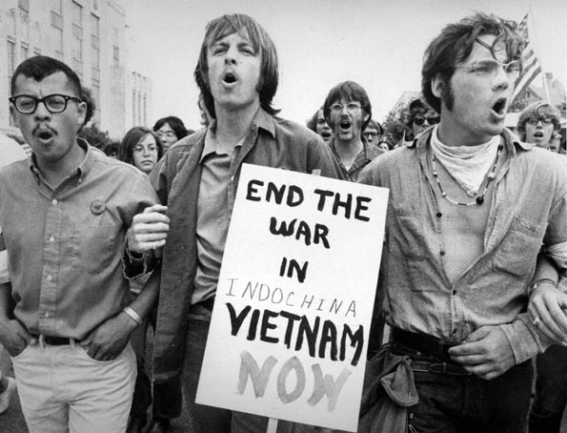
Generations
As Groups
How Generations Grew Up

Slide 2
Do Now
What do you know about the generations that preceded you?
Do you feel like there is a level of misunderstanding between
yourself and people that are members of other generations?
Why does society label different decades of people with a
“generation name”?
List some things you associate with the following groups
based on what you already know:
Baby Boomers Generation X Golden Age
Me Generation Millenials/Generation Y

Slide 3
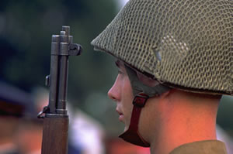
GI/Postwar Generation
Born 1901-1926
Children of the WWI generation & fighters in WWII &
young in the Great Depression...all leading to strong models
of teamwork to overcome and progress.
Strongly interested in personal morality and near-absolute
standards of right and wrong.
Strong sense of personal civic
duty, which means they vote.
Marriage is for life, divorce
and having children out of
wedlock were not accepted.

Slide 4
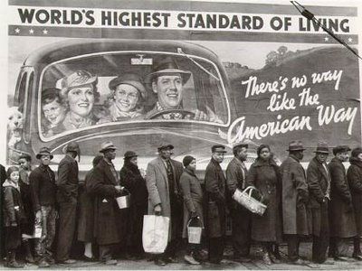
GI/Postwar Generation
There was no "retirement"
you worked until your died
or couldn't work anymore.
Age of radio and air flight;
they were the generation
that remembers life without
airplanes, radio, and TV.
Most of them grew up without modern conveniences
like refrigerators, electricity and air conditioning.
Strong loyalty to jobs, groups, schools, etc.
Members: Joe DiMaggio, John F. Kennedy, Judy Garland

Slide 5
Silent Generation
1925-1945
Include those to young to serve in WWII
Many fathers served in WWI
Generally children of Great Depression-had severe impact on them
Considered cautious, unimaginative and withdrawn, they grew up in a time of conformity. They needed a cause.
MEMBERS: JIM HENSON, BOB DYLAN AND ARETHA FRANKLIN.

Slide 6
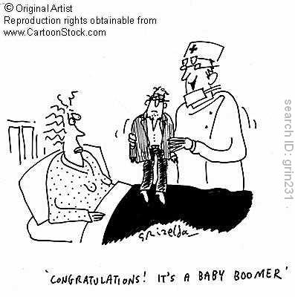
Baby Boomers
Born between 1946 and 1964
"Rock and roll" music
generation.
Ushered in the free love and
societal "non-violent"
protests which triggered
violence.
Self righteous & self-centered.
The first TV generation.
The first divorce generation,
Where divorce was beginning to be accepted as a tolerable
reality.

Slide 7

Baby Boomers
One of the largest generations in history with
77 million people.
Envision technology and innovation as requiring a
learning process.
Optimistic, driven,
team-oriented.
Began accepting
homosexuals.
MEMBERS: AL GORE JR. AND
STEVEN SPIELBERG.

Slide 8
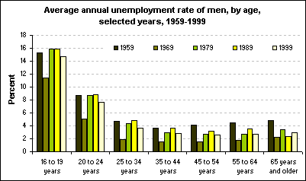

Slide 9
Subset of Baby Boomers-Generation Jones
Born: 1954-64
A subset of boomers, these are people who missed out on revolutionary 1960’s and still want to make their mark.
Members: Oprah Winfrey and Bill Gates.

Slide 10
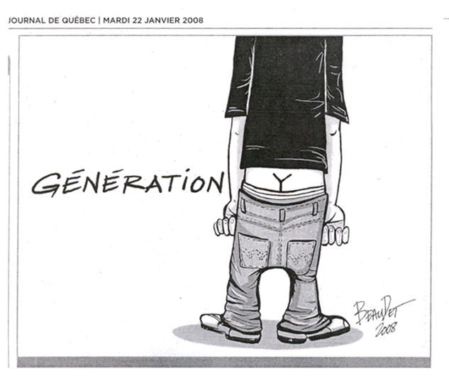
Generation X
Born between 1965 and 1980
The "latch-key kids" grew up street-smart but isolated,
often with divorced or career-driven parents. Latch-Key
came from the house key kids wore around their neck,
because they would go
home from school to an
empty house.
Very individualistic.
Government and big
business mean little to them.
Feel misunderstood by
other generations
Members: Uma Thurman, Beyonce
Vin Diesel.

Slide 11
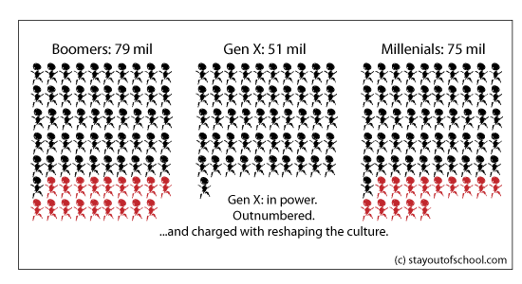
Generation X
Raised in a transition phase of technology and learning,
computers and technology enter schools during teen years.
Cynical of many major institutions, which failed their
parents, or them, during their formative years and are
therefore eager to make marriage work and "be there"
for their children.
Cautious, skeptical,
unimpressed with
authority, self-reliant.
AIDS and drug
problems at their
peak.

Slide 12
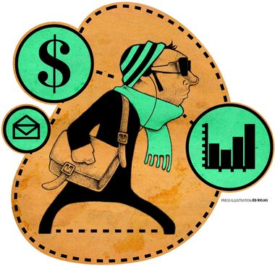
Millenials
Born between 1981 and 2000
They are nurtured by omnipresent parents, optimistic,
and focused.
Falling crime rates. Falling
teen pregnancy rates.
They feel enormous
academic pressure.
With unlimited access to
information tend to be
assertive with strong views.
Envision the world as a
24/7 place; want fast and
immediate processing.
Members: Prince William
Kirsten Dunst, Lebron James
http://www.youtube.com/watch?v=BGGa-9d-5oQ

Slide 13
How Would You
Characterize the Next Generation?
Every generation has acquired a title by society based on
the events that took place, the culture that the people
grew up in and lifestyle choices they made during those
years. Given what you know about society today:
Come up with a title for the next Generation (Generation Z)
Create a Poster on this Generation
Be Sure to explain through words/drawings why you gave it that name
Name and Draw some things you would associate with your generation (will also help in your explanation!)

Slide 14
Homework
Every generation went through life altering,
or memorable events that those people will
never let go of. Find one article, or event
that occurred during a particular generation
and explain how that event may have shaped
the way that generation grew up and lived.
Due next class worth 15 points!

