Slide 1
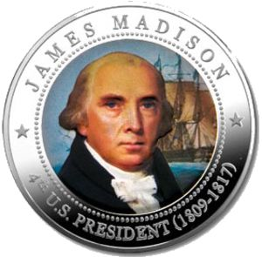
James Madison’s Presidency:
Transcending Jefferson
*Picking up after Thomas Jefferson since 1809*
Created by: Jodie David, Sarah Barnett, Scarlett Bekus, and Jillian Szczepanski

Slide 2
I am your father…….
Of the Constitution

Slide 3
The Name’s Madison, James Madison
Born: March 16th, 1751 in Port Conway VA
Education: Princeton University
Political Experiences:
Outlined VA’s Constitution
Wrote the U.S. Constitution, “Father of the Constitution”
Secretary of State under Jefferson’s presidency

Slide 4
Election of 1808
Major Candidates:
Madison (Republican) Winner
C.C. Pinckney (Federalist)
George Clinton (Republican)
Major Issues: Foreign Relations

Slide 5
Election of 1812
Major Candidates:
Dewitt Clinton (Federalist)
James Madison (Republican) Winner
Major Issue: War of 1812

Slide 6
First Term’s Main Issues
Domestic: Rechartering of the Bank of the U.S.
•Opposition from Republicans
thought bank was unconstitutional & too much Hamiltonian power
**Anti-British objected to bank stock held by British & state banks**

Slide 7
Saving the Bank
•Re-charter stopped at first by anti-Bank forces
•1816 (2nd term), the 2nd Bank chartered w/ a 20 year term
•Critics thought re-charter showed pro-Federalist compassion

Slide 8
Foreign: France and Britain
Non-Intercourse Act (1809)
Replaced Jefferson’s embargo, trade w/ all countries except France and Britain
Macon’s Bill No. 2
Free commerce w/ GB and F only if neutral ships were respected
**Ineffective b/c GB doesn’t listen- War of 1812**

Slide 9
Foreign: The British
Chesapeake Incident (1807)
Prime example of impressment
British seized American sailors & forced service on Brit. Ships
**Major factor leading to War of 1812**
War Hawks
Group of Republicans led by John C. Calhoun
Rallied for war w/ Britain Successful
Wanted to invade Brit. Canada & take Spanish out of FL

Slide 10
Second Term: Major Issues
Domestic: Displease of Federalists in New England
Federalist Party in US: dying down
Majority of New England still Fed.
Feds. unhappy w/ continuous growing # of Republicans
Began to speak of creating a new nation w/ the remaining feds.

Slide 11
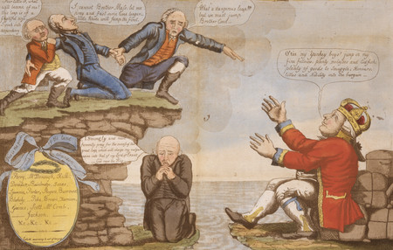
How It’s Handled: The Hartford Convention
Took place in Connecticut
Delegates from states in New England
Discuss possibility of secession (separate & form new nation)
Idea of Secession=futile
7 amendments to Constitution proposed: all denied
Nothing accomplished except demise of Federalist party

Slide 12
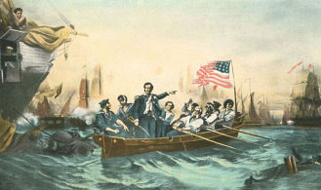
Foreign: The Empire Strikes Back
War of 1812:
Cause:
GB: ~Impressment of American sailors (Impressment: serve in British navy or die)
~Provided weapons for Native Americans (Native Americans attacked U.S. settlements)
~Placed major trade restrictions on U.S.

Slide 13
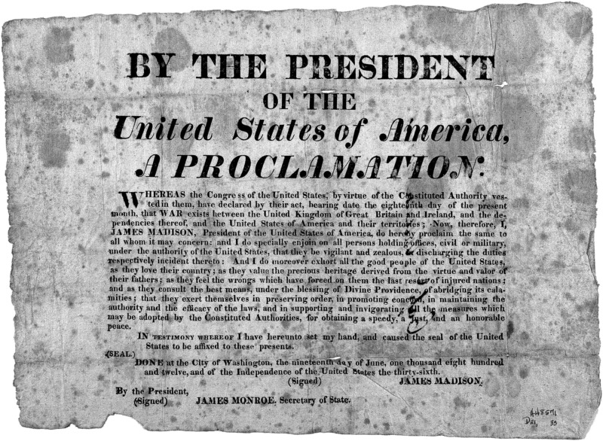
How Madison Handled It
Congress: Declare official War w/ Britain -June 18^{th,} 1812
~Became known: Second War for Independence
Declaration of War

Slide 14
Battles of the War of 1812: America
Lost many battles but won great victories at New Orleans and Lake Champlain
New Orleans- Jan 8th 1815-
Major General Jackson defeated British attack-
Greatest victory in War of 1812
Took place while Treaty of Ghent was being signed
Lake Champlain- Sept. 11th 1814-
Astonishing naval victory
Brought Vermont into the war

Slide 15
Results of the War of 1812: America
*Resume Trade with Britain and France (1815)*
Rush- Bagot Treaty (1817)- U.S. and GB- limits naval weapons & equipment on Lake Champlain &Great Lakes

Slide 16
Results of War of 1812: Land
49th Parallel (1818)- Distribution of land between U.S. and Canada (U.S. gains more land)
Joint Occupation of Oregon Territory (1819)- U.S. and GB can’t decide who gets territory so both share it for 10 yrs to make a decision in the future

Slide 17
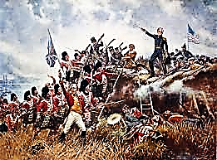
Results of the War of 1812: Britain
Burned down White House and other pol. Buildings
Stopped at Fort McHenry
*Inspiration for U.S. National anthem, “The Star- Spangled Banner”
Treaty of Ghent (1814) U.S. and GB- Ends War- nothing major gained either side
Battle Of New Orleans

Slide 18
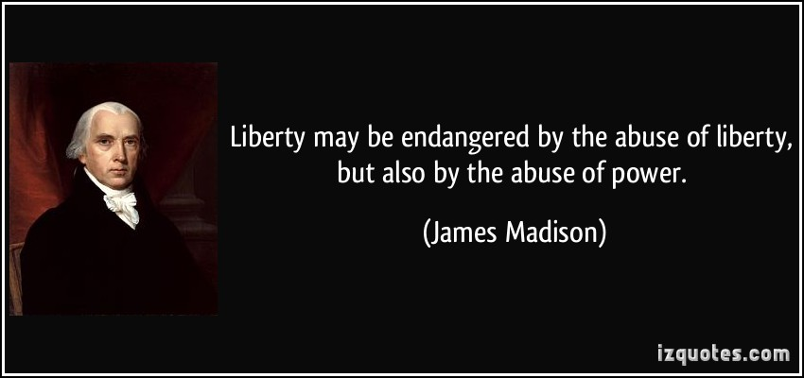
“
“

Slide 19
Bibliography
"ConnecticutHistory.org." ConnecticutHistoryorg The Hartford Convention or Leap No Leap Comments. N.p., n.d. Web. 04 Dec. 2013
"I_beta/blog." Darth Vader on TEDxEutropolis. I_beta/blog, n.d. Web. 09 Dec. 2013.
"James Madison." History.com. A&E Television Networks, n.d. Web. 09 Dec. 2013.
"James Madison Quote." Iz Quotes. N.p., n.d. Web. 09 Dec. 2013.
"Miller Center." American President: James Madison: Foreign Affairs. University of Virginia, n.d. Web. 03 Dec. 2013.
"Beyond the Bubble." The War of 1812. N.p., n.d. Web. 9 Dec. 2013. <https://
"Posts Tagged With: Bankers." Conspiracies Fact or Fiction Truth or Lie. N.p., n.d. Web. 09 Dec. 2013.
"Poor William's Almanack, March 16, 2013, Self-deprecation." Poor William's Almanack, March 16, 2013, Self-deprecation. ABC Internet., n.d. Web. 09 Dec. 2013.
"Wikipedia." Wikipedia. N.p., n.d. Web. 03 Dec. 2013.
"War of 1812 Bicentennial Plans Fall Flat - November 17, 2010." War of 1812 Bicentennial Plans Fall Flat - November 17, 2010. N.p., n.d. Web. 09 Dec. 2013.
"1812 Presidential Election." 1812 Presidential Election. N.p., n.d. Web. 09 Dec. 2013.

