Slide 1
All About Skylanders
Written By
Evan

Slide 2
Table of Contents
Chapter 1 Meet the Skylanders | 1
Chapter 2 How the Portal of Power Works | 2
Chapter 3 Legendary Skylanders | 3
Chapter 4 Meet Chaos the Boss | 4
Diagram | 5
Different Kinds of Skylanders | 6
Interesting Fact | 7
Glossary | 8
Index | 9
Conclusion | 10

Slide 3
Chapter 1
Meet the Skylanders.
Wrecking ball is really cute but not strong.
And teeny bit of smartness does not move much.
They got a medal.

Slide 4
How the Portal of Power Works
The portal of power can work any Skylander in the world also the BOSS.

Slide 5
Legendary Skylanders
Legendary slam bam is a legendary Skylander.
And even tree rex is legendary too and they can’t get fired.

Slide 6
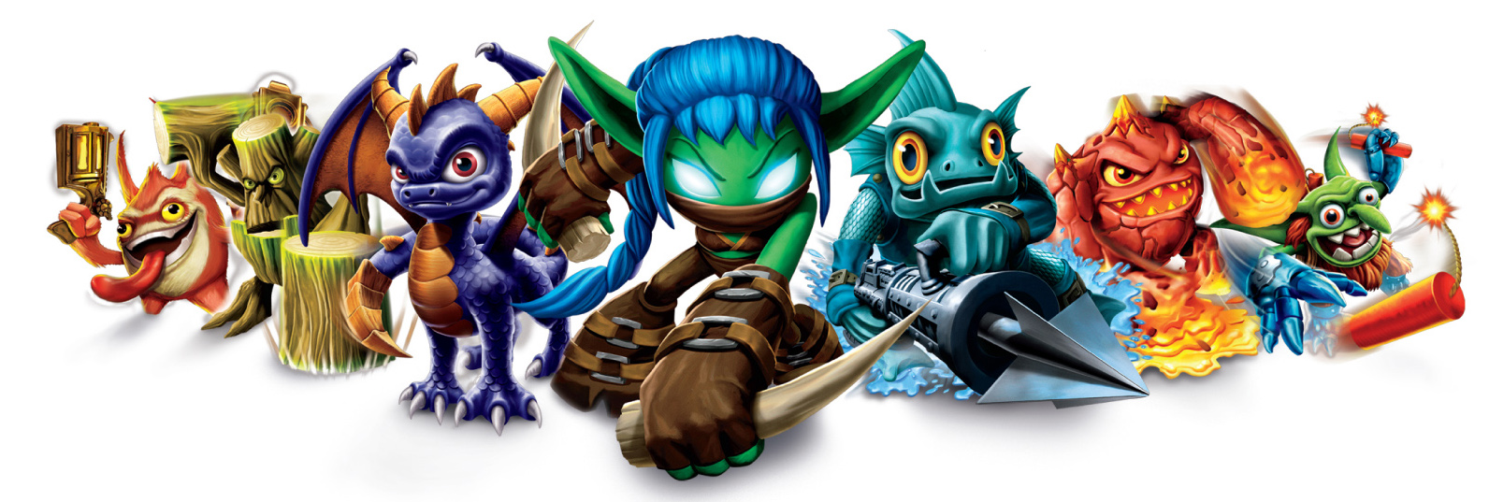
Diagram
Stump smash
Gill grunt
spyro
Trigger happy
Flame slinger
erupter
Pop fizz

Slide 7
Different Kinds of Cool Skylanders
Eyebrow

Slide 8
Interesting Fact
Only one Skylander can heal, and it can be cool.

Slide 9
Glossary
BOSS a person that you try to kill.

Slide 10
Conclusion
Now you know all about Skylanders. You can go online to get them.

