Slide 1
Poodles
By
Diya and Krish

Slide 2
Table of Contents
Table of contents
Poodle history
Poodle play time
Looks
Fun facts

Slide 3
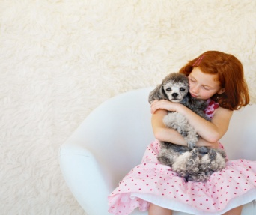
Poodle history
There 3 sizes, The standard, miniature, and the toy. Toy Poodles are the smallest poodles.
Standard poodles are the biggest. Miniature poodles are in the middle. Poodles have floppy ears. Poodles like to be indoors and outdoors. When you get a poodle ,Its not used to you so it will be aggressive to you and bite you, train it everyday to 15/20 miniuts . The first poodle was in the 1400s

Slide 4
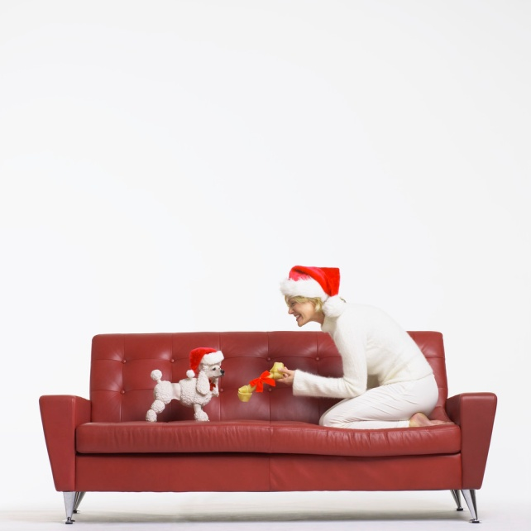
Poodle play time
Most dogs are hard to train but poodles are the easiest ones to train. To train your poodle do it with soft stuffed animals no hard plastic in it. For standard poodles you don’t need stuffed toys even though there poodles.

Slide 5
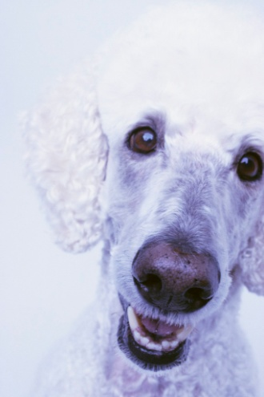
Looks!
Toy poodles look so sweet. They have floppy ears and sharp muzzles. Miniature poodles look the same as the toy poodle but the toy poodle is different. If you buy a poodle you have to give it a really big haircut. Standard poodles do not look the same.

Slide 6
Fun facts!
People think poodles are only girls but there not! There both girls and boys! Poodles are popular and smart. Poodles don’t like mean poodles or other dogs. Poodles are carnivores.

Slide 7
Glossary
Aggressive- a dog that scratches and bites.
Carnivores- meat eaters.
Muzzles- nose and mouths part of a dog.
Standard- a size.
Train- to teach it its lesson or what to do.

Slide 8
Sources
Poodles by Bobbie kalman
Poodles by Lynn M. stone
Poodles by Marc Crabtree

