Slide 1
Chapter 4
Electron Configurations
By Mr. English

Slide 2
Light as a wave
4.1 Objectives
  Describe wave in terms of frequency, speed, wavelength and amplitude
  List and explain the wave-like properties of light
  Identify the major regions of the electromagnetic spectrum

Slide 3
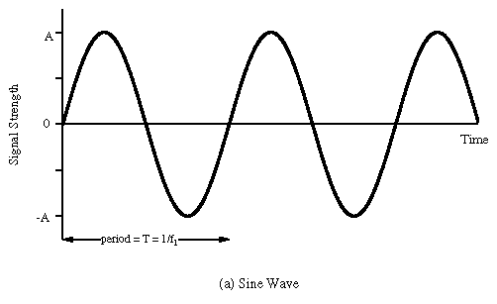
Aspects of a wave
Wavelength
  Typical units: nanometers (nm), meters (m)
Amplitude
  Typical units: volts/meter (this measurement is very important to radio broadcasters. WHY?)

Slide 4
Aspects of a moving wave
Frequency= number of wave cycles/ unit time
  Typical units: cycles/sec, 1/sec, sec⁻¹, Hertz, Hz
  All of the units above mean EXACTLY the same thing
Period= unit of time per wave cycle
  Typical units: sec/cycle, sec, minutes, hours
Speed=distance traveled per unit time
  Typical units: m/sec, cm/sec, miles/hour, (unit length)/(unit time)

Slide 5
Properties of waves
Waves can interfere constructively or destructively with themselves
They can be diffracted
Waves of different frequencies bend at different angles when they pass through a series of parallel slits
These are all properties of light

Slide 6
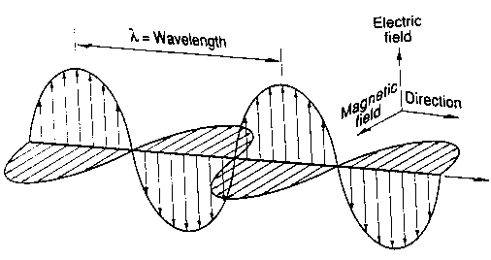
What is a light wave
Vibrating magnetic field generates electricity
Vibrating electric fields generate magnetism
James Clerk Maxwell (mid 19th century) calculated (from simple electrical experiments) the speed of a wave generated from a vibrating electric and magnetic field: 3 x 10⁸ m/s

Slide 7
Electromagnetic Radiation
James Clerk Maxwell (mid 19th century) calculated (from simple electrical experiments) the speed of a wave generated from a vibrating electric and magnetic field: 3 x 10⁸ m/s
This was almost exactly the same as the speed of light, which was known at the time.
What do you think Maxwell concluded?

Slide 8
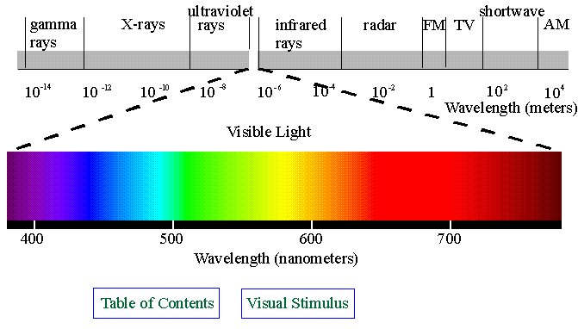
Electromagnetic spectrum
The electromagnetic spectrum includes many types of energy unknown to Maxwell.

Slide 9
Electromagnetic spectrum
What type of equipment (or natural senses) might be used to detect the amplitude of:
  Shortwave
  Microwave
  Radar
  Visible
  Ultraviolet
  X-rays

Slide 10
C=λν
C = 3.00 x 10⁸ m/sec, the speed of EM waves
λ is lamda, the wavelength
ν is nu, the frequency
nm (nanometers)=10⁻⁹ meters
What is the frequency of a red light, 625nm?
Solve by dimensional analysis

Slide 11
What is the frequency of a red light, 625nm?
First record all “given” information, or relevant info from other sources
  λ=625 nm, c=3.00 x 10⁸ m/sec, 10⁹ nm = 1 m
Identify relevant formulas or relationships between variables.
  c=λν, ν=c/λ , λ=c/ν
The units must balance when you solve
  ν=c/λ = 3.00 x 10⁸m 1_____ 10⁹ nm = 4.80 x 10¹⁴ sec⁻¹
  sec 625 nm 1 m
Evaluate
  Is the answer reasonable, is it written with correct significant digits, does it have a correct unit, is it the answer that was requested in the problem.

Slide 12
More problems
What is the wavelength of an x-ray with a frequency of 2.55 Hz
What is the frequency of a EM wave with a length of 2.00 meters. What part of the EM spectrum is this in?
Determine the fastest rate you might be able to shake a handheld magnet. What frequency? What wavelength is this? What part of the spectrum?
How fast would you have to wag the magnet to generate visible light?

Slide 13
Light as a particle
4.2 Objectives
  Explain what is meant by quantum energy
  Solve problems relating energy of radiation, wavelength, and frequency
  Discuss the dual nature of radiant energy

Slide 14
Hot!
Heated objects give off radiant energy

Slide 15
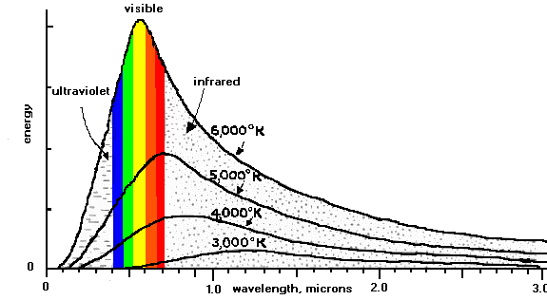
Study the picture below to answer the questions
What temperature is a star which emits with a maximum intensity at 0.9 microns (900 nm)
A candle flame burns at around 2000 K. Is its maximum intensity above, below, or within the visible range of wavelengths?

Slide 16
Max Planck’s Theory (~1900)
Planck proposed an explanation for the relationship between temperature and distribution of radiant wavelengths.
His explanation required that energy is made up of small indivisible parts he called “quanta”
How is this similar to atomic theory?
Plank’s equation: E=hν
  Relates frequency to the size of the quanta
  h (Plank’s constant) = 6.6261 x 10⁻³⁴ Jsec

Slide 17
Can any color be used to charge a glowing object?
Red Yellow Green Blue

Slide 18
Photoelectric effect
Photoelectric effect is similar to the glowing paint effect
Electrons are ejected from the surface of certain metals when light shines on the metal
This can be used to generate an electric current, as in solar batteries.
But there is a minimum threshold frequency, below which the solar battery will not work at all, REGARDLESS OF THE LIGHTS INTENSITY

Slide 19
Einstein’s Explanation
Quanta can be thought of as “particles of light” which Einstein called photons
An individual photon either has enough energy to knock the electron off the surface of the metal, or it doesn’t
If the size of the individual photons are too small, it doesn’t matter how many of them strike the metal (how intense the light), the electrons will not be ejected.
E=hν is the formula to determine if the light has achieved the minimum threshold frequency to eject an electron.

