Slide 2
Chapter 4
“Electron Configurations”
The Key to Understanding Chemistry*
*Modified extensively from slides
by Mr. Matt Davis.

Slide 3
OBJECTIVES
Describe a wave in terms of its frequency, wavelength, speed & amplitude.
Identify the regions of the electromagnetic spectrum.
Relate energy of radiation to its frequency.
Explain what is meant by a “quantum of energy.”
Distinguish between a ‘continuous’ spectrum & a ‘line’ spectrum.
State the main idea in Bohr’s model of the hydrogen atom.
Describe atomic orbitals in terms of shape, size & energy.
Determine the electron configurations of elements using the principles of orbital energy, orbital capacity & electron spin.

Slide 4
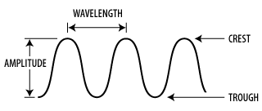
4-1 “Radiant Energy”
Recall that electromagnetic waves consist of…
ORIGIN -------------------------------------------------------------
Amplitude – height of wave measured from the origin
to a crest (brightness).
Wavelength – distance between successive crests (one full cycle).
Frequency – how fast the wave oscillates up and down.

Slide 5
Properties of Electromagnetic Waves
Amplitude, wavelength, frequency, speed
Speed of light: c = 3.00 X 10⁸ m/s (or 3.00 X 10¹⁰ cm/s )
  This is constant!
c = λ·ν (where λ is wavelength & ν is frequency)
  Notice the inverse relationship between λ and ν.

Slide 6
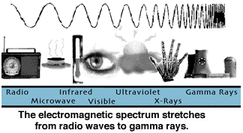
The Electromagnetic Spectrum
(See page 129 of text.)

Slide 7

Visible Spectrum
(Roy G. Biv)
This is a “continuous” spectrum.

Slide 8
Class Activity - Waves
Using the yarn provided, create on a sheet of paper a wave with…
  low frequency and low amplitude.
  high frequency and low amplitude.
  high frequency and high amplitude.
  low frequency and high amplitude.
Calculate the wavelength of yellow light emitted by a sodium vapor lamp if its frequency is 5.10 X 10¹⁴ Hz (or s⁻¹).
  Ans: 5.8 X 10⁻⁵ cm

Slide 10
OBJECTIVES
Describe a wave in terms of its frequency, wavelength, speed & amplitude.
Identify the regions of the electromagnetic spectrum.
Relate energy of radiation to its frequency.
Explain what is meant by a “quantum of energy.”
Distinguish between a ‘continuous’ spectrum & a ‘line’ spectrum.
State the main idea in Bohr’s model of the hydrogen atom.
Describe atomic orbitals in terms of shape, size & energy.
Determine the electron configurations of elements using the principles of orbital energy, orbital capacity & electron spin.

Slide 11
4-2 Quantum Theory
Wave model of light was generally accepted.
It did not account for certain observations.
  Why do hot object glow different colors?
  Why do elements emit certain colors (e.g. neon, sodium, mercury)?
Max Planck proposed…
  There is a fundamental restriction on the amount of energy an object emit or absorbs, which he called a “quantum.”
  E = h ν, where h is Planck’s constant, 6.6262 X 10⁻³⁴ J-s.
  Analogies: Car acceleration (continuous vs. quanta), and a ramp versus stairs.

Slide 12
4-2 Quantum Theory (cont’d)
Photoelectric Effect: When light hits the surface of a metal, electrons are given off.
Only certain wavelengths work! (For example, violet works, but red does not.)
Einstein used Planck’s equation to explain this puzzling effect:
  Light consists of energy quanta (photons)!
  A photon transfers energy to an electrons in the metal atom.
  The metal absorbs ‘all or nothing’ depending on the wavelength (energy) of light.
  The intensity of light does not matter; only the wavelength (color) matters.

Slide 13
4-2 Quantum Theory (cont’d)
Compton Effect: A photon of light can hit an electron, causing a change in motion of each.
  Similar to billiard balls colliding.
  This effect clearly showed the double nature of radiant energy.
  Light has properties of BOTH waves and particles (duality).
So what? Let’s see how these experiments and ideas improved our understanding of the atom.

Slide 14
Light & Electrons Compared
Light behaves mostly like a wave, but a little like a particle.
Evidence: Einstein predicted, and scientists confirmed, that light is bent by the sun’s gravity; also, the Compton effect illustrates this property of light (photons).
Electrons have a wave-particle duality.
Electrons have their momentum changed by light waves.

Slide 15
4-3 Another Look at the Atom
Incandescent light bulbs give a ‘continuous spectrum’ of all visible colors.
  This is what we call “white light.”
Neon bulbs do not! They produce bright colors and specific spectral lines.
Mercury vapor and sodium vapor lamps also have characteristic colors and definite spectral lines as well.
Salt solutions of certain elements also emit certain colors (and lines).
Why do these ‘line spectra’ occur? Let’s look at some examples.

Slide 16
Examples of “Line” Spectra
http://www.colorado.edu/physics/2000/quantumzone/index.html
Activity & Lab: Gas discharge tubes and flame tests.
The explanation lies in understanding the hydrogen atom.

Slide 17
The Hydrogen Atom
The hydrogen atom has only one proton & one electron.
Hydrogen gives line spectra
  Paschen series (infrared lines)
  Balmer series (red, green, blue, purple lines)
  Lyman series (ultraviolet lines)
Why are there lines rather than a continuous spectrum?

Slide 18
Bohr’s Proposal
Rutherford’s planetary model of the atom, with electrons circling the nucleus, suggested to Niels Bohr a dramatically different model that incorporated Plancks’ idea of quantization…
…fixed orbits!

Slide 19
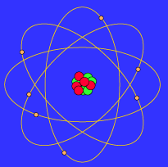
The Bohr Model
Electrons in
fixed orbits
(quanta).
NUCLEUS
(protons &
neutrons).

Slide 20
The Bohr Model (cont’d)
The basic ideas behind Bohr's model of the hydrogen atom are:
The electron moves in a circular orbit around the proton.
Only certain orbits are stable. This means there are fixed, ‘quantized’ orbits where the electron can be found. The electron will never be found or be able to exist anywhere between these orbits.
Each orbit has a different energy level, and each is labeled by a quantum number, n, with the lowest energy level assigned n = 1, followed by 2, 3, etc.

Slide 21
Electron Locations & Quantum Numbers (n)
Ground State – the lowest energy level of an electron in an atom (closest to the nucleus).
  Corresponds to Quantum Number n = 1.
Excited State – a level of higher energy, reached by the absorption of an appropriate amount of energy (quantum).
  Correspond to Quantum Number n = 2, 3, 4, etc.
But how do electrons get from the Ground State to an Excited State?
And what happens when they get there?

Slide 22
Quantum Leaps
-These are the jumps that electrons make when moving from one energy level to another.
-An electron has to absorb a certain quantum of energy to get from the ground state to an excited state.
-But an excited state is not stable, so the electron eventually releases energy (radiation) and returns to the stable ground state.
-We see colors emitted when electrons with certain energy levels fall back from the excited state to the ground state. (Not all frequencies are visible, though.)
-Bohr used this model and Planck’s equation (E = hν) to predict the frequencies in the line spectrum of the hydrogen atom. The calculations matched the experimental results, supporting the model!

Slide 23
Refining the Bohr Model of the Atom
Bohr’s model correctly predicts the line spectrum of hydrogen.
But it fails to predict the line spectrum of larger atoms like the ones we observed earlier.
Nevertheless this was an important step in our understanding the atom!

Slide 24
Matter Waves
Before 1900, matter (such as electrons) was thought of in terms of particles, and energy was considered to be waves.
But light was shown to behave like particles (photons with quanta of energy).
Louis De Broglie suggested that matter behaves like waves, just as waves of light behave like particles (photons)!
This is the concept of “matter waves.”
  Concept was verified by experiments when electrons (thought to be particles) were shown to behave like waves! (Electron microscopes.)
  All moving objects have a wavelike behavior, but the effect is only observable for very small particles like electrons.

Slide 25
Pulling it Together
Matter and energy simultaneously have the properties of both particles and waves!
Duality of nature.

Slide 26
One more idea helps…
…the Heisenberg “Uncertainty Principle.”
It is impossible to know both the location and momentum of an electron at the same time.
(The very act of making the measurement affects the electron’s position, as in the Compton effect!)
But, we know we are LIKELY to find an electron somewhere around an atom.

Slide 28
OBJECTIVES
Describe a wave in terms of its frequency, wavelength, speed & amplitude.
Identify the regions of the electromagnetic spectrum.
Relate energy of radiation to its frequency.
Explain what is meant by a “quantum of energy.”
Distinguish between a ‘continuous’ spectrum & a ‘line’ spectrum.
State the main idea in Bohr’s model of the hydrogen atom.
Describe atomic orbitals in terms of shape, size & energy.
Determine the electron configurations of elements using the principles of orbital energy, orbital capacity & electron spin.

Slide 29
4-4 A New Approach to the Atom
Let’s review what we know:
  Atoms consist of a dense positive core (nucleus) containing protons (1+) & neutrons (0 charge).
  Electrons (1-) are around the nucleus.
  Most of the atom is just empty space.
  Electron energy is quantized.
  Light is absorbed as an electron moves from one energy level to a higher energy level.
  Light is emitted as an electron returns to a lower energy level.
  Electrons have wavelike behavior.
  One cannot measure the momentum & position of an electron simultaneously.
  There is a certain probability (likelihood) of finding an electron around an atom.

Slide 30
Bohr Model vs. Quantum Mechanical (Q-M) Model
90% probability line.
←
Bohr: nuclear atom, but
electrons are in fixed orbits.
Q-M: nuclear atom, but electrons
are in orbitals, which describe
the probability of finding
an electron in that space.

Slide 31
Probability & Orbitals
Probability of finding an electron around a nucleus can be viewed as a “fuzzy cloud” of negative charge.
High electron density describes the regions of highest probability.
Atomic Orbital – region around the nucleus of an atom where an electron of given energy is likely to be found.
Orbitals differ from orbits.
  Orbitals do not tell how the electron moves.
Contour surfaces are used to describe orbitals. (See pages 141 - 142.)

Slide 32
Orbital Shapes
Orbitals are labeled…
  s (sharp)
  p (principal)
  d (diffuse)
  f (fundamental)…
s orbitals are always spherical.
p orbitals are always like dumbbells.
d, f & above are more complex.

Slide 33
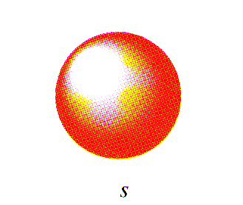
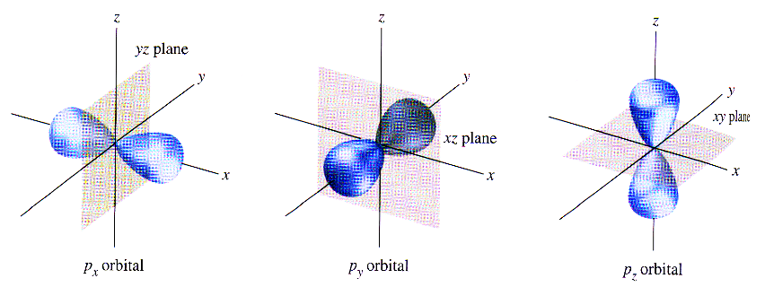
s Orbitals:
Shapes of s and p Orbitals
p Orbitals:
Note: The p orbitals are oriented along an x, y or z axis.

Slide 34
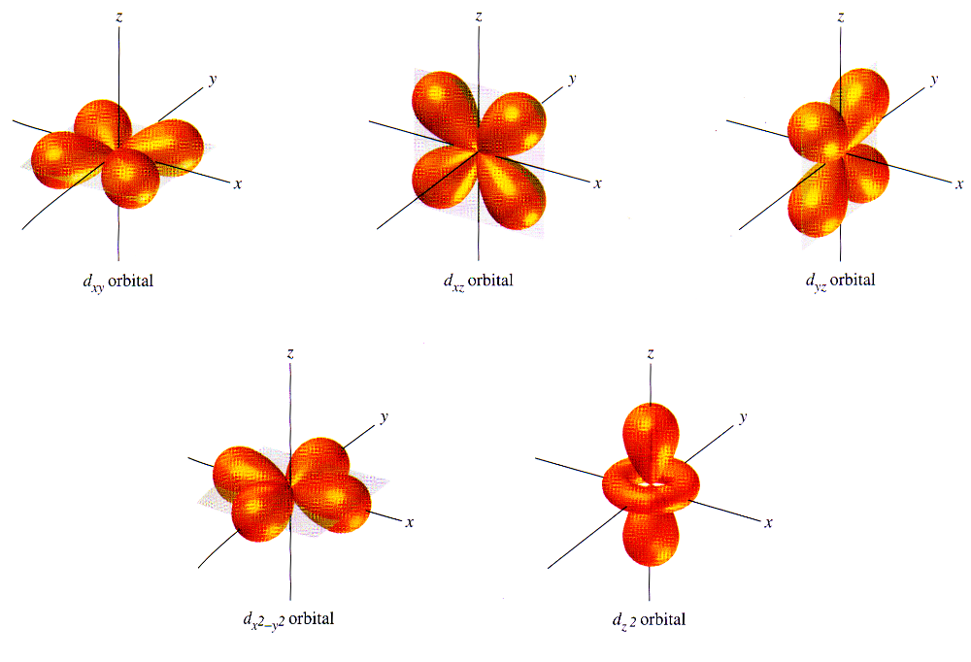
Shapes of d Orbitals:

Slide 35
Orbitals and Energy (See Fig. 4-24)
The principal energy levels are designated by the principal quantum number, n.
Energy level increases with n.
  n =1 is lowest energy, then n = 2, n = 3…
Each principal energy level is divided into one or more sublevels.
  n = 1 has only one sublevel.
  n = 2 has two sublevels.
  n = 3 has three sublevels.
  n = 4 has four sublevels
  etc.

Slide 36
Summary of Energy Levels, Sublevels & Orbitals
Principal Energy Level | Sublevels | Total Number of Orbitals ( ) | Total Number of Electrons
n = 1 | 1s | 1s (one) | 2
n = 2 | 2s + 2p | 2s (one) + 2p (three) | 2 + 6 = 8
n = 3 | 3s + 3p + 3d | 3s (one) + 3p (three) + 3d (five) | 2 + 6 + 10 = 18
n = 4 | 4s + 4p + 4d + 4f | 4s (one) + 4p (three) + 4d (five) + 4f (seven) | 2 + 6 + 10 + 14 = 32
Notes: The number of sublevels equals the value of n, the
principal quantum number; each orbital can hold only two electrons.

Slide 37
Energy Diagram (See p 143)
n = 4
 |  | n= 3 | _ _ _ _ _ _ _ 4f _ _ _ _ _ 4d _ _ _ 4p
 | n = 2 | _ _ _ _ _ 3d _ _ _ 3p __ 3s | __ 4s
n = 1 | _ _ _ 2p __ 2s
__ 1s
Increased Energy

Slide 38
Important Facts About Orbitals
As n increases, the energy of the orbital increases (as does the energy of electrons in those orbitals).
Higher energy orbitals are farther away from the nucleus.
The size of orbitals increases as n increases, but they retain their basic shape.
The overall electron density of an atom is a superimposition of all orbitals in the atom.
Certain orbitals, such as 3d and 4s, are very close in energy. (The 4s is slightly lower than the 3d.)

Slide 39
Another Property of Electrons: Spin
Electrons behave as if they are tiny magnets due to their property of spin.
Electrons spin clockwise ( ) or counterclockwise ( ) on their axis.
Spinning creates a small magnetic field.
Paired spins cancel, but parallel spins are additive, making the atom magnetic (as in iron).
Wolfgang Pauli proposed the “Pauli Exclusion Principle”:
  Each orbital in an atom can hold 2 electrons only, and they must have opposite spins (i.e., spin paired).

Slide 40
Summary (so far!)
1. At the center of the atom is a small, dense, positively charged nucleus consisting primarily of protons and neutrons.
2. Moving around the nucleus are negatively charged electrons which account for only a tiny fraction of the atom's mass -- the bulk of the mass being in the nucleus. Most of the atom is empty space.
3. The electrons in an atom have only certain quantized energies.
4. Light of a specific color is emitted or absorbed when electrons change from one energy state to another.
5. The "Heisenberg Uncertainty Principle" states that the position and momentum of an electron cannot be simultaneously determined.
6. Even though the electron's exact position cannot be determined, theory predicts the probability that an electron could be at a particular region (orbital) for a given energy.
7. If the probability location of an electron of known energy is plotted in space, the plot looks like a fuzzy cloud.
8. In an atom with many electrons, the clouds of one shell are superimposed in space with those of other shells.
9. Electrons possess a property called spin.

Slide 41
Does It Work?
The quantum-mechanical model of the atom
is accepted because it -
-correctly predicts very complex line
spectra of heavy atoms.
-accounts for the physical and chemical
properties of elements.
-explains observed periodic trends.
-helps us understand molecular structures.
-is the key to understanding chemistry!

Slide 43
4-5 Electron Configurations
This refers to the distribution of electrons among orbitals of an atom.
It is determined by distributing electrons among levels, sublevels and orbitals according to these rules:
  Aufbau Principle
  Pauli Exclusion Principle
  Hund’s Rule
Orbital diagrams are used to write the electron configurations.

Slide 44
The Rules for Electron Configurations
Aufbau Principle: Electrons are added one at a time to the lowest energy orbitals until all electrons have been included.
Pauli Exclusion Principle: An orbital may hold only two electrons, and their spins must be opposite (paired).
Hund’s Rule: Electrons occupy equal-energy orbitals to maximize the number of unpaired electrons.
Let’s do some EXAMPLES! (Board activity and worksheets.)

Slide 45
Exceptions to the Aufbau Principle
Recall that some orbitals are very close in energy.
  This is especially true for large atoms having lots of d and f orbitals.
  This causes certain orbitals to fill before one would normally expect.
Chromium and copper illustrate the exceptions (page 153).
  A certain amount of energy stability results from half-filled orbitals, and this accounts for the orbital filling order in Cr and Cu.

Slide 46
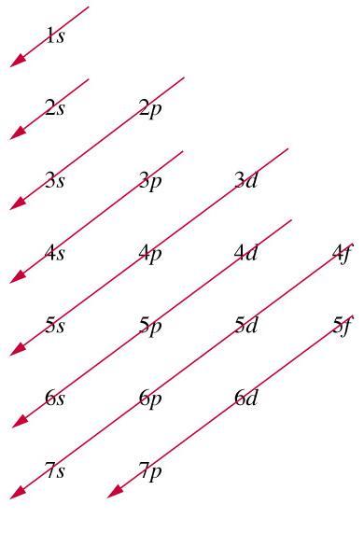
Orbital Filling Order
This pneumonic shows how the complex orbitals of large atoms
overlap and fill “out of order.”

Slide 47
Did we meet the Chapter 4 OBJECTIVES?
Describe a wave in terms of its frequency, wavelength, speed & amplitude.
Identify the regions of the electromagnetic spectrum.
Relate energy of radiation to its frequency.
Explain what is meant by a “quantum of energy.”
Distinguish between a ‘continuous’ spectrum & a ‘line’ spectrum.
State the main idea in Bohr’s model of the hydrogen atom.
Describe atomic orbitals in terms of shape, size & energy.
Determine the electron configurations of elements using the principles of orbital energy, orbital capacity & electron spin.

Slide 48
WOW! We sure covered a lot of territory!
You have finished a very difficult, but important,
chapter in Chemistry.
CONGRATULATIONS!

Slide 49
Additional material for AP
Principle quantum number is symbolized “n”, has values of 1,2,3,4… etc
Azimuthal (or angular momentum, or orbital) quantum number is symbolized “l”, has values of 0,1,2 (up to n-1)
Magnetic quantum number is symbolized m_{l}, has values of 0, +1, -1 (up to +/- l)
Spin quantum number is symbolized ms, has only two possible values +1/2 and -1/2

Slide 50
“iso” means “the same”
Isotopes (same # protons)
Isotones (same # neutrons)
Isobars (same mass #)
Isoelectronic (ions with same #electrons)

Slide 51
Question
List some ions which are isoelectronic with argon.
List some isotopes which are isobars with Lead 207

Slide 52
Mass number, vs atomic mass
“mass number” only applies to specified isotopes of a given element
Carbon 12, or ¹²C are separate but equivalent notations for the most common isotope of carbon- one with 6 protons and 6 neutrons
“atomic mass” is the non-integer value given on the periodic table, representing the average mass of all the various isotopes in a natural sample of the pure material.

Slide 53
Questions
Why is the atomic mass of carbon not a perfect integer, even though the mass of individual carbon atoms can be perfectly described by an integer?
Lead is the final decay product from a number of radioactive elements. Would the atomic mass for lead collected from the waste at a nuclear disaster site be the same as the atomic mass of lead collected from other sources? How about the atomic number? Defend your answer

Slide 54
magnetism
Ferromagnetism (ordinary magnetism) occurs when electron spins align with an applied magnetic field, and remain aligned when the field is removed (to create a seemingly permanent magnet)
Paramagnetic materials (like aluminum) show a much weaker attraction to magnets, and do not maintain any magnetic properties when the applied magnetic field is removed. Elements with unpaired electrons can be paramagnetic.

Slide 55
Diamagnetic materials
Diamagnetic forces are weaker than either ferromagnetism, or paramagnetism. All materials show some degree of diamagnetism. Materials (like most organic materials) which are neither paramagnetic nor ferromagnetic, are actually repelled by magnets (but very weakly).

Slide 56
Diamagnetism
Diamagnetic properties can only be observed when the applied field is extremely strong.
http://www.hfml.ru.nl/pics/Movies/strawberry.mpg
http://www.hfml.ru.nl/pics/Movies/frog.mpg

Slide 57
Degenerate orbitals
“degenerate” means orbitals which are exactly equal to one another in terms of their absolute energy
Which rule or principle applies to electrons filling degenerate orbitals, when writing electron spin diagrams?
The magnetic spin quantum states +1/2 and -1/2 are ordinarily degenerate. What could you do to make these different spin states non-degenerate?

Slide 58
Naming regions of the hydrogen spectrum
Different regions of the hydrogen spectrum are named for the scientists who first discovered them.

Slide 59
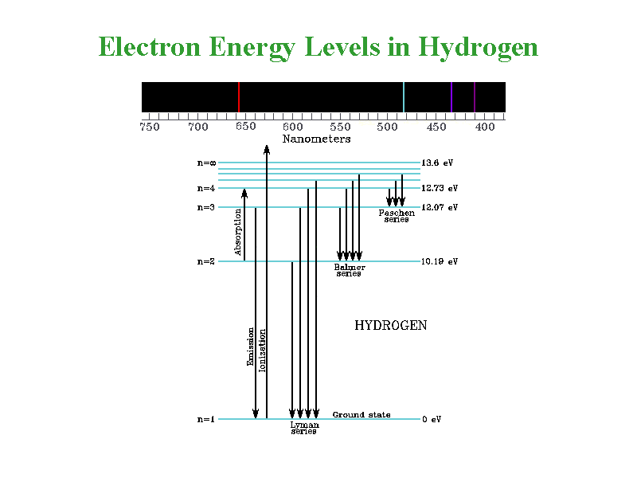
Lyman, Balmer, and Paschen

