Slide 1
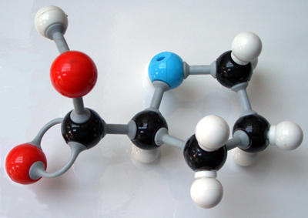
Session #38
Representing Molecules In 3-D

Slide 2
Ball & Stick Models
Kit Inquiry
What elements would each color best represent? Explain your reasoning for each color.
Explain what your group thinks all of the other parts represent and why.
Create two models that you believe represent actual molecules and name each.
Hint- keep it simple! (you are making MOLECULES)

Slide 3
Molecule Model Key
White board the molecular model kit key your group created.
Be able to justify the choices made for each piece of the kit
Consider the types of molecules and bonds that you would need to form.
Can a color represent a family of elements not just a single type?

Slide 4
Making Models
Complete the Making Molecular Models activity
Relate the shape created to its name
Determine a pattern that connects the Lewis Dot Structures to the 3-D Models.
What is the relationship between pairs of electrons around the central atom and shape?
How does a single, double, or triple bond relate to the shape?

