Slide 1
What is characterization?

Slide 2
CHARACTERIZATION
Characterization is the process of revealing the personality and appearance of a character in a book, movie, etc.
In order to interest and move readers, characters need to seem real. Authors achieve this by providing details that make characters individual.
Good characterization gives readers a strong sense of characters' personalities and complexities; it makes characters vivid, alive and believable.

Slide 3
Direct Characterization - The reader is told directly what the character is like by the writer.
Indirect Characterization - The reader has to use his/her own judgment to decide what a character is like, based on the evidence given to you by the writer.

Slide 4
INDIRECT CHARACTERIZATION
A writer can reveal character traits by:
letting us hear the character speak
describing how the character looks and dresses
Letting us listen to the character’s inner thoughts and feelings
Revealing what other characters in the story think or say about the character
Showing us what the character does (how he/she acts)

Slide 5
CHARACTER TYPES
Major
Major vs. Minor Characters
Major or central characters are vital to the development and resolution of the conflict. In other words, the plot and resolution of conflict revolves around these characters.
Minor characters serve to complement the major characters and help move the plot events forward.

Slide 6
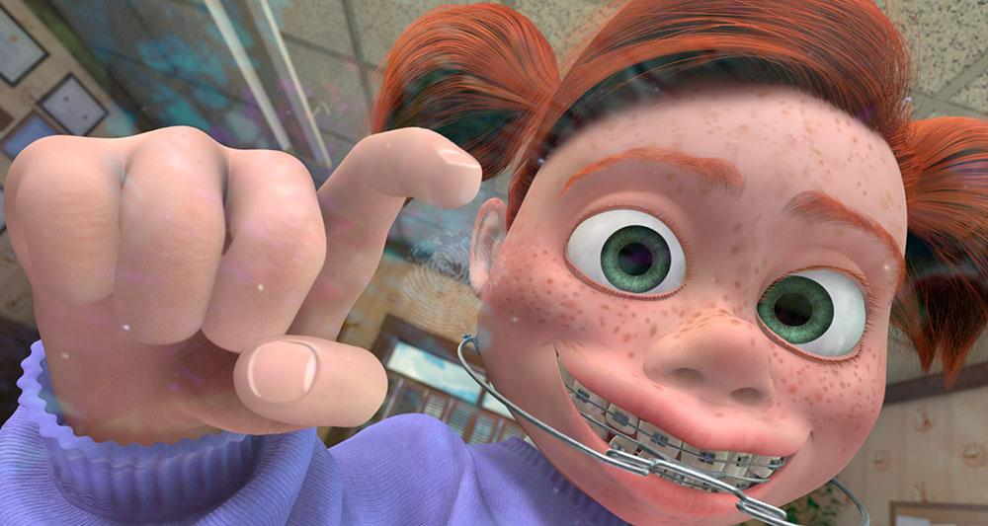
Let’s look at some examples from Finding Nemo. Major or Minor?
Major
Darla: is a minor character because although helps move the story along, she is not vital for the plot to continue to unfold.

Slide 7
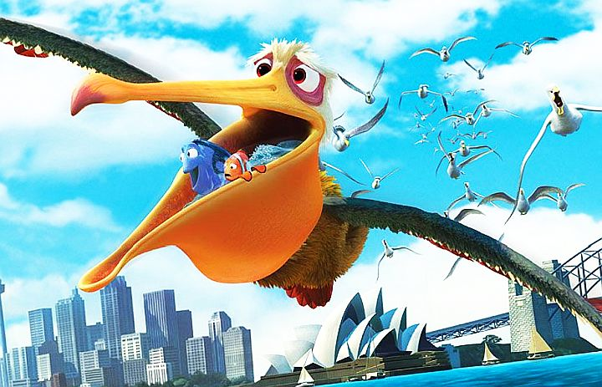
Major or Minor?
Nigel: is a minor character because, while he helps move the story along, he is not central to the story’s plot.

Slide 8
Dynamic vs. Static Characters
Dynamic - A dynamic character is one who undergoes an important change due to the action of the plot. Often this change is a result of resolving a central conflict or facing a major crisis. Most dynamic characters tend to be central rather than peripheral characters because resolving the conflict is the major role of central characters.
Static - A static character is someone who does not change over time; his or her personality does not transform or evolve. Therefore, the audience’s knowledge of the character does not grow.
Major

Slide 9
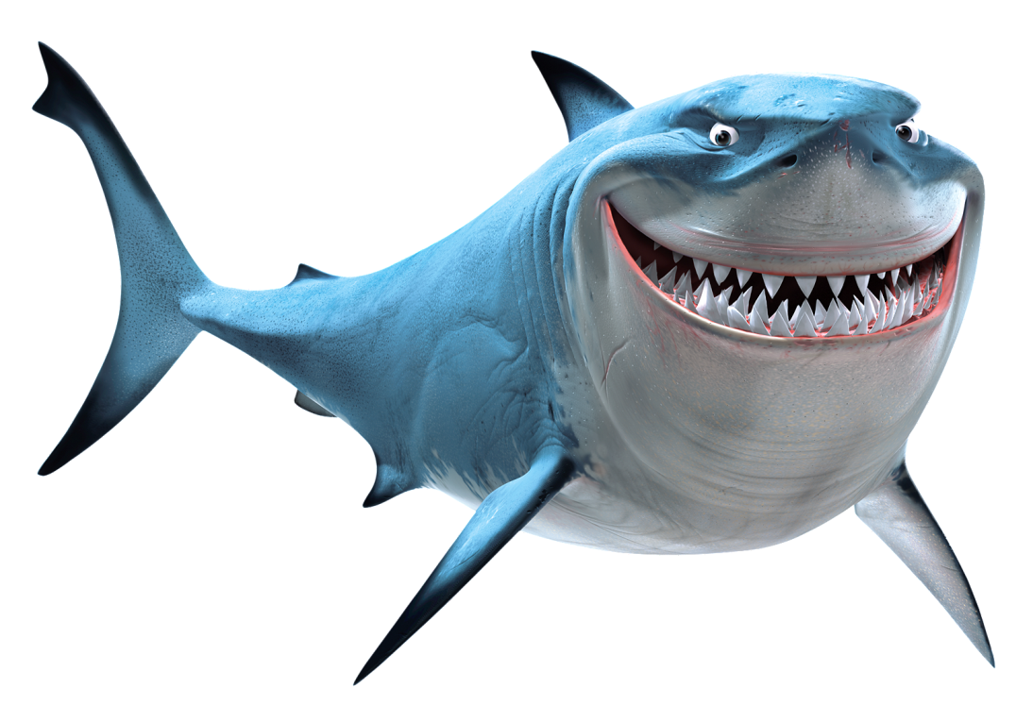
DYNAMIC OR STATIC?
Major
Bruce is a DYNAMIC character because he “works on himself” to overcome the need to eat other fish, and becomes a “better” shark. Since he changes, he is considered dynamic.

Slide 10
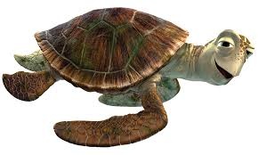
DYNAMIC OR STATIC?
Major
Crush: is a static character because he does not undergo any change during the course of the story.

Slide 11
Flat vs. Round Characters
Major
Round - A round character is anyone who has a complex personality; he or she is often portrayed as a conflicted and contradictory person.
Flat – embodies one or two qualities or traits that can easily be recognized. Often a stereotype.

Slide 12
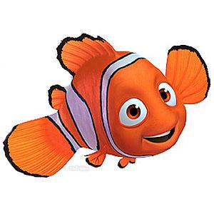
ROUND OR FLAT?
Major
Nemo: is a round character because he has a complex personality. We see many sides of his personality, such as bravery, fear, independence, determination, etc.

Slide 13
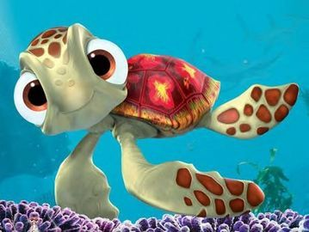
ROUND OR FLAT?
Major
Squirt: is a flat character. He (or is it she??) is basically any kid – cute, friendly, etc. but lacking depth of character.

Slide 14
Protagonist/Antagonist
Major
Protagonist - the central character(s) in a story, and is often referred to as the story's main character. He or she (or they) is faced with a conflict that must be resolved.
Antagonist - the character(s) who deceives, frustrates, or works against the main character and helps to create the conflict. In other words, the antagonist is the enemy that the protagonist must overcome or conquer.

Slide 15
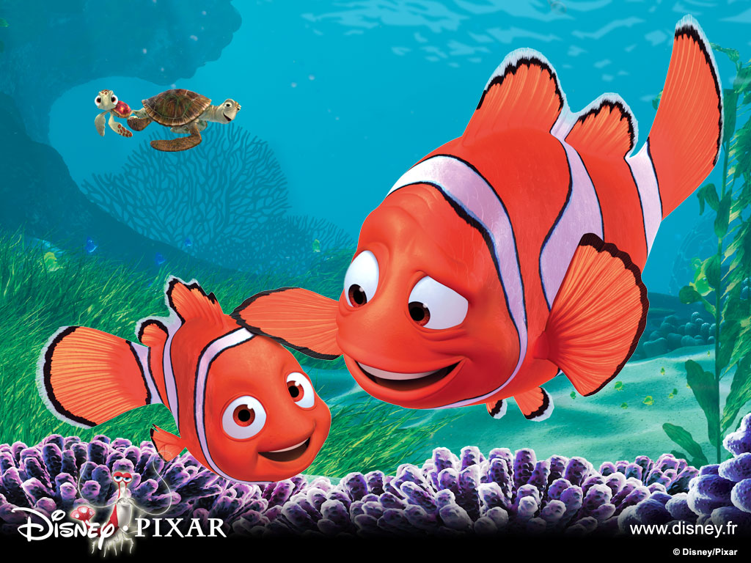
Protagonist or antagonist?
Marlin: is a protagonist since he is a central character and involved in a major conflict – getting his son back.

Slide 16
FOIL
Foil - any character (usually the antagonist or an important supporting character) whose personal qualities contrast with another character (usually the protagonist). By providing this contrast, we get to know more about the other character.

Slide 17
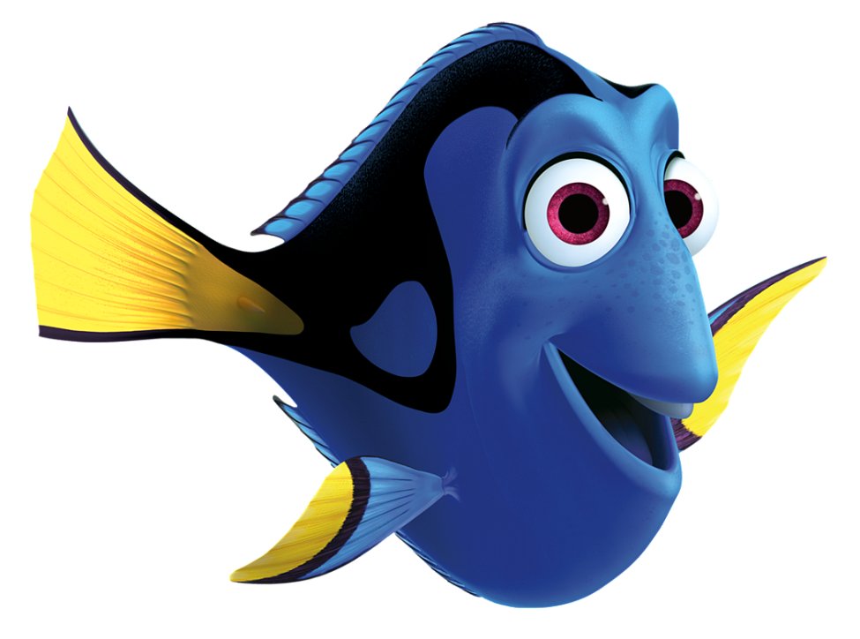
FOIL?
Dory can be considered a foil to Marlin. While he is always cautious and worried, she contrasts these traits with her carefree and courageous personality.

Slide 18
TO SUMMARIZE:
Major/Minor Characters
Dynamic/Static Characters
Round/ Flat Characters
Protagonist/ Antagonist
Foil

