Slide 1
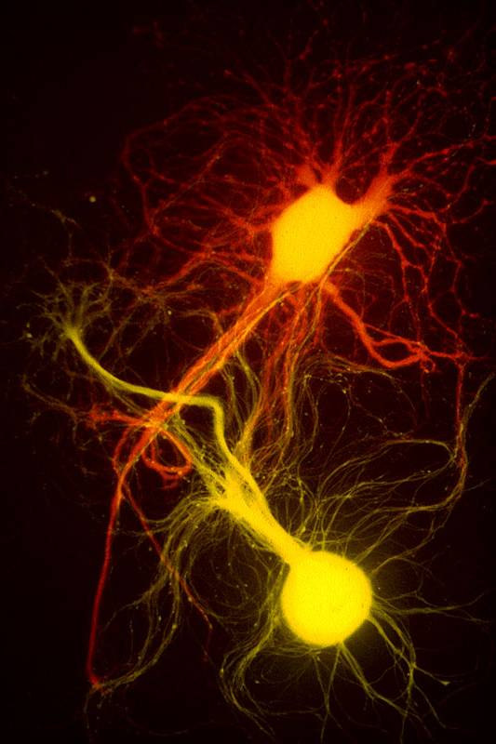
Nerves Chapter 48
Notes:
Figure 48.0x1 Aplysia neuron

Slide 2
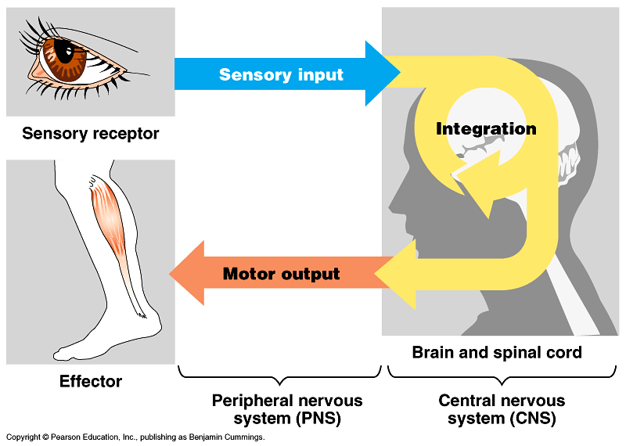
General Nervous System Functions
Control of the internal environment
Nervous system works with endocrine system
Difference?
Voluntary control of movement
Spinal cord reflexes
Assimilation of experiences necessary for memory and learning

Slide 3
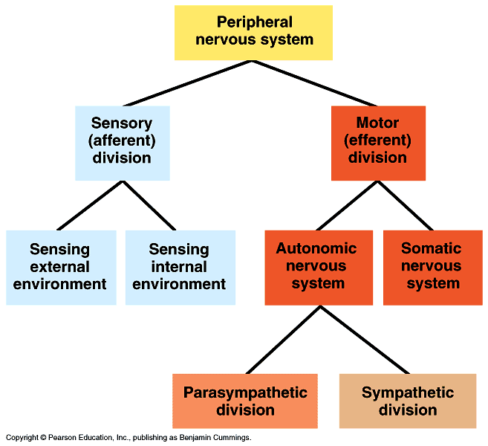
Organization of the Nervous System
Central nervous system (CNS)
Brain and spinal cord
Peripheral nervous system (PNS)
Neurons outside the CNS
Sensory division
Afferent fibers transmit impulses from receptors to CNS
Motor division
Efferent fibers transmit impulses from CNS to effector organs
Somatic system to muscle
Autonomic system

Slide 4
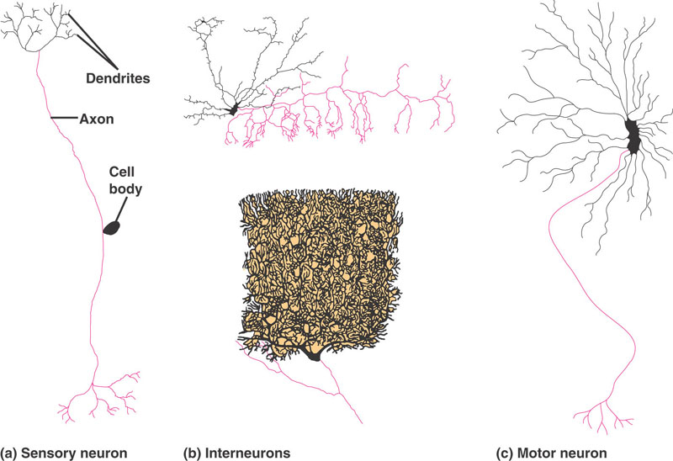
Neuronal diversity

Slide 5
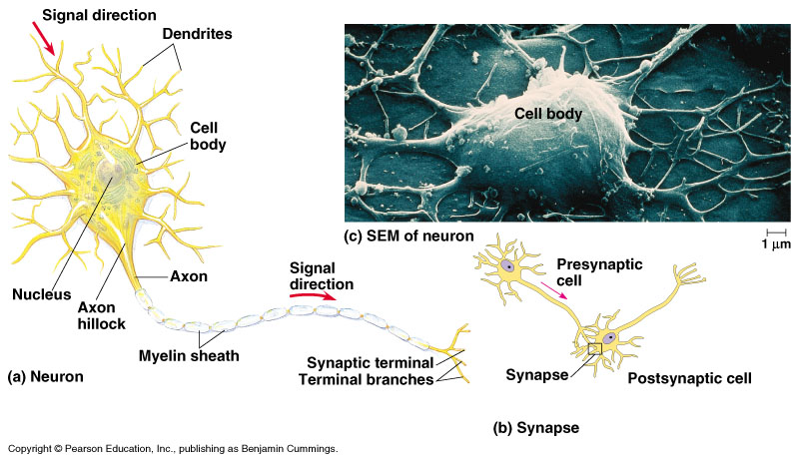
Structure of a Neuron
Cell body
Dendrites
Conduct impulses toward cell body
Axon
Carries electrical impulse away from cell body
May be covered by Schwann cells
Form discontinuous myelin sheath along length of axon
Synapse
Contact points between axon of one neuron and dendrite of another neuron

Slide 6
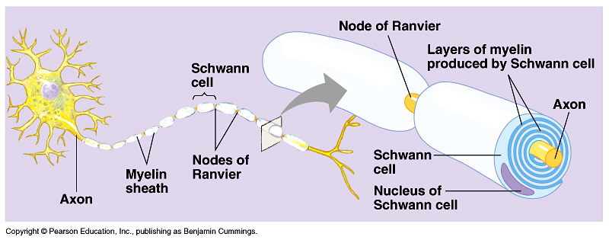
Figure 48.5 Schwann cells

Slide 7
Electrical Activity in Neurons
Resting membrane potential
At rest, neurons are negatively charged
Action potential
Potential across membrane changes

Slide 8
Sodium (Na⁺) Potassium (K⁺) pump
Cells maintain low intracellular [Na⁺]
440mM outside, 50 mM inside
Cells maintain high intracellular [K⁺]
560mM inside, 90mM outside
Ions cannot diffuse through lipid bilayer

Slide 9
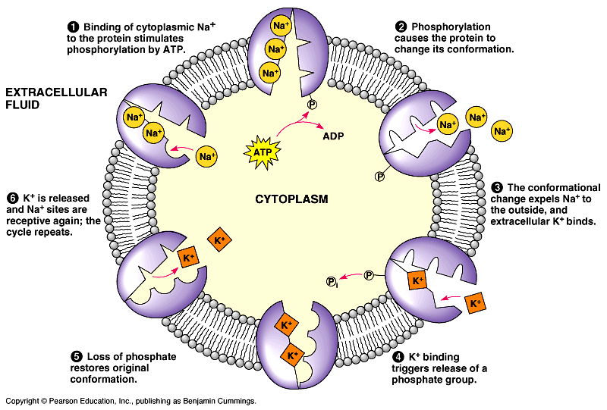
The sodium-potassium pump: a specific case of active transport
Notes:
Nerve cells and for co-transport

Slide 10
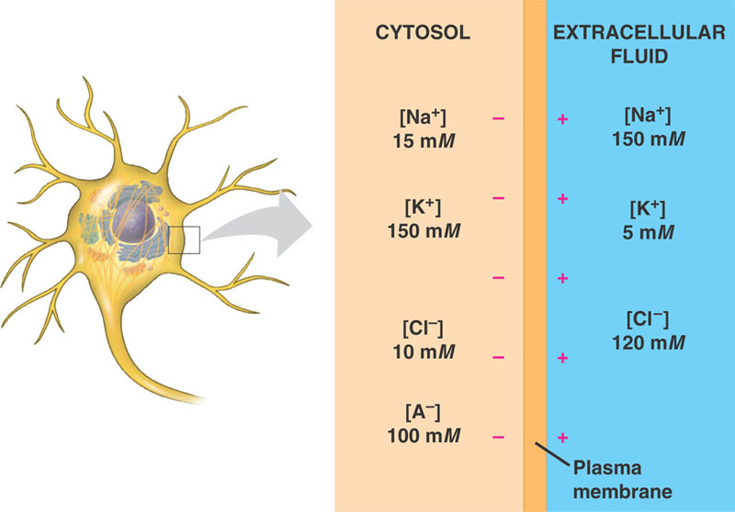
The basis of the membrane potential
Resting Potential

Slide 11
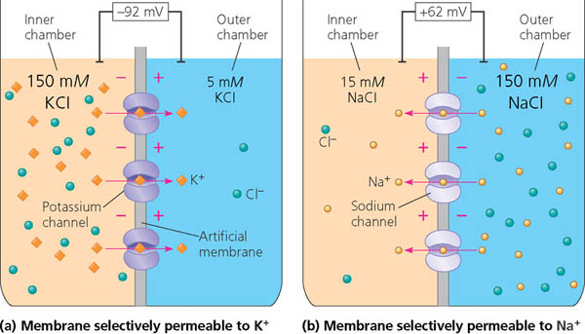
Modeling a mammalian neuron
Donnan Equilibrium- the behavior of charged particles near a semi-permeable membrane to sometimes fail to distribute evenly across the two sides of the membrane. The usual cause is the presence of a different charged substance that is unable to pass through the membrane and thus creates an uneven electrical charge.
Resting Potential
Notes:
Draw Donnan equilibrium

Slide 12
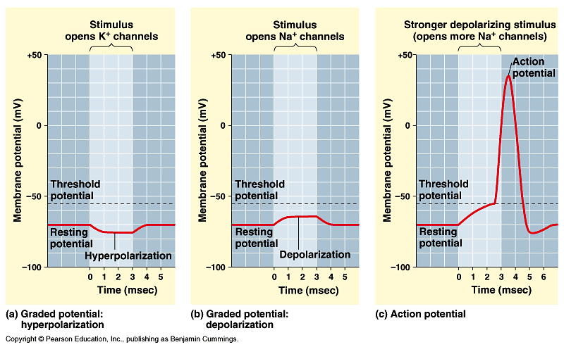
Graded potentials and the action potential in a neuron

Slide 13
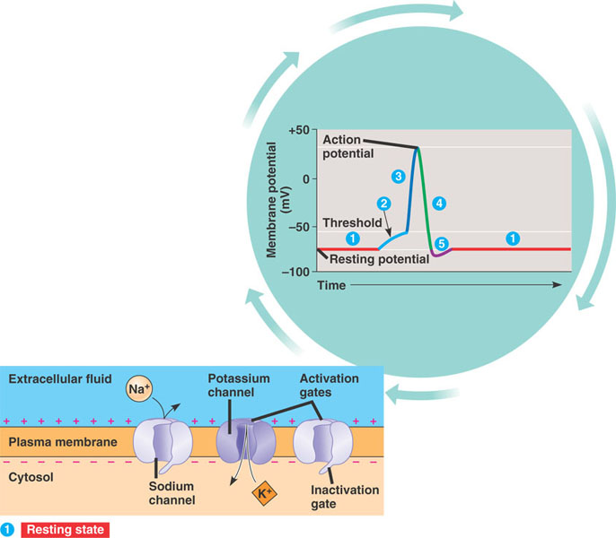
The role of voltage-gated ion channels in the action potential (Layer 1)

Slide 14
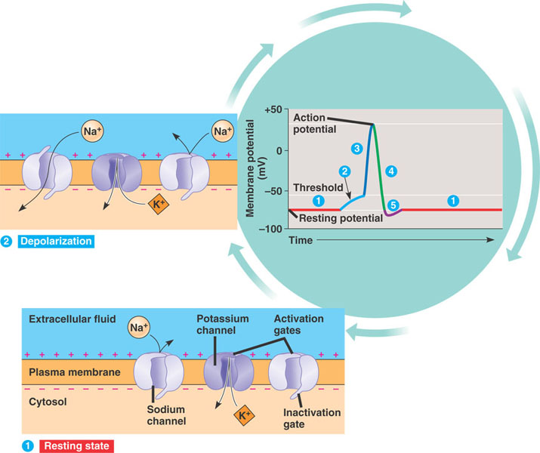
The role of voltage-gated ion channels in the action potential (Layer 2)

Slide 15
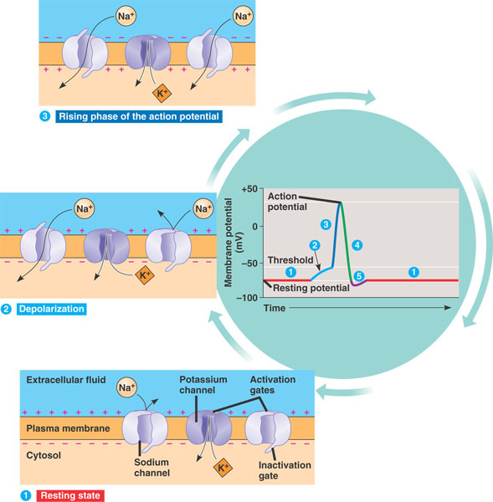
The role of voltage-gated ion channels in the action potential (Layer 3)

Slide 16
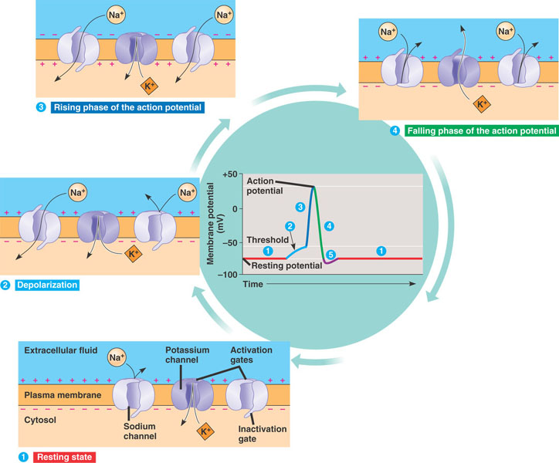
The role of voltage-gated ion channels in the action potential (Layer 4)

Slide 17
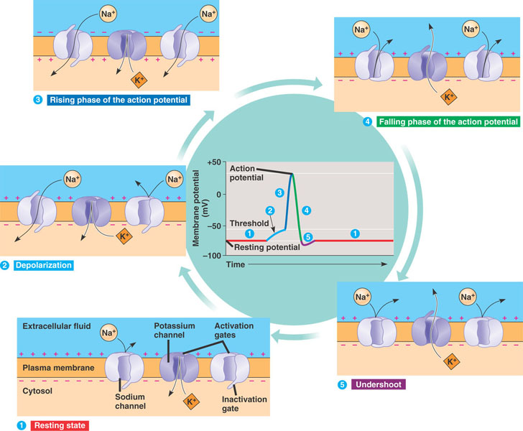
The role of voltage-gated ion channels in the action potential (Layer 5)
Notes:
Refractory period

Slide 18
Action Potentials

Slide 19
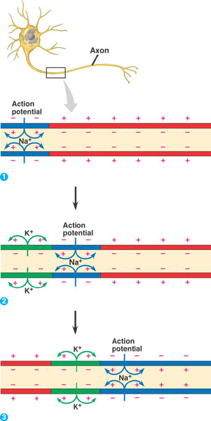
Propagation of the action potential

Slide 20
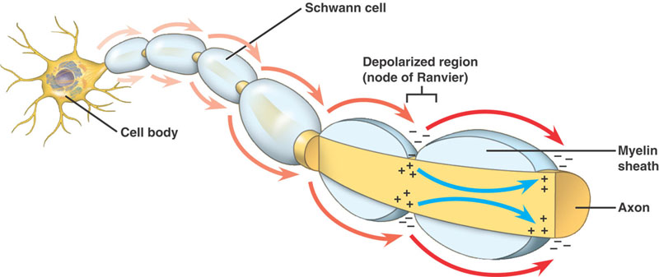
Saltatory conduction

Slide 21
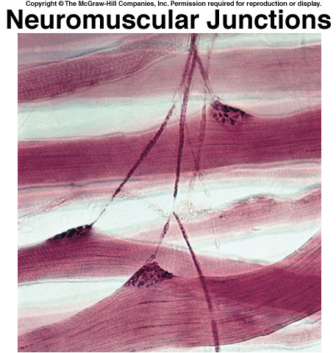
Synapses
Electrical
Gap junctions
fast
Chemical
Neurotransmitters
slow

Slide 22
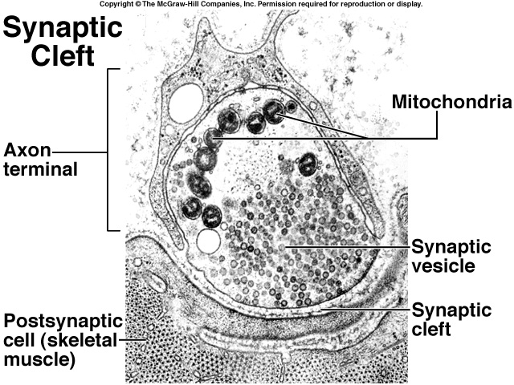
Neurotransmitters and Synaptic Transmission
Neurons communicate across synapses using neurotransmitters
Released from presynaptic membrane
Binds to receptor on post synaptic membrane
Excitatory transmitters
Cause depolarization (EPSP)
Inhibitory transmitters
Cause hyperpolarization (IPSP)

Slide 23
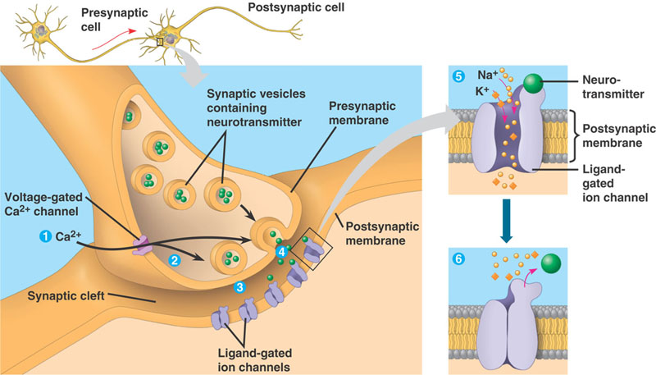
A chemical synapse
Synaptic cleft approximately 20nm across
Signal passes from pre-synaptic to post-synaptic cell

Slide 24
Synaptic Signaling

Slide 25
Neurotransmitters
Must be released by pre-synaptic cell
Must elicit effect on post-synaptic cell
Agonists should work the same way
Must be removed after action
Can be small molecules or large peptides

Slide 26
Elimination of Neurotransmitters
Essential for transient signal
Chemical breakdown
Acetylcholinesterase
Reabsorption
Serotonin
Dopamine

Slide 27
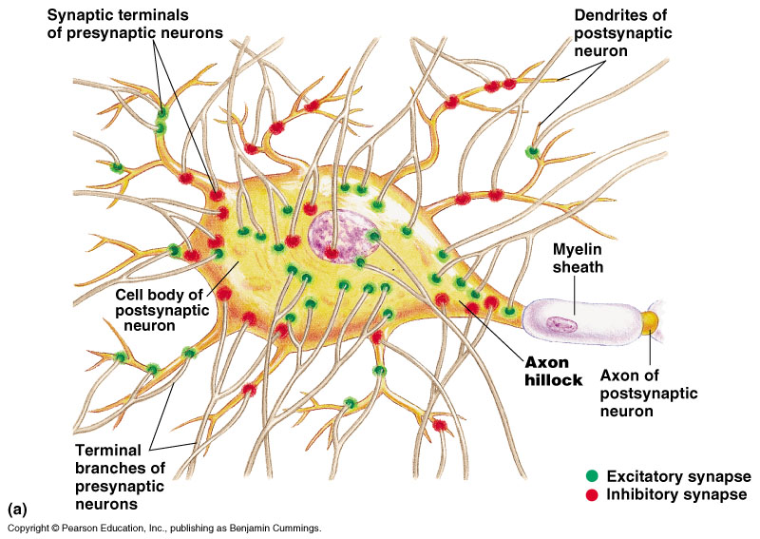
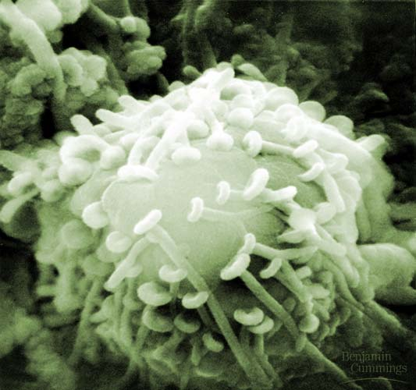
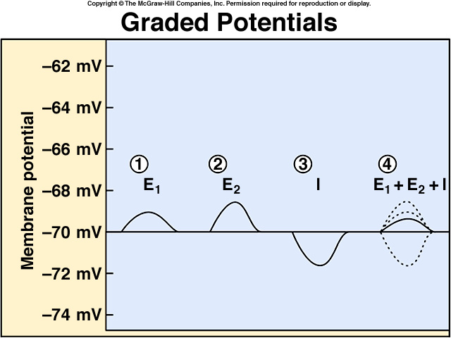
Integration of multiple synaptic inputs

Slide 28
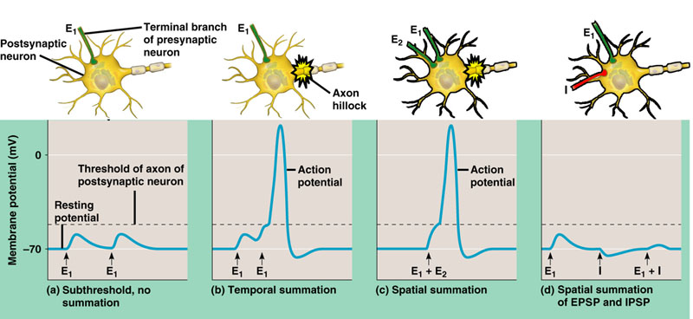
Figure 48.18 Summation of postsynaptic potentials
Excitatory transmitters
Cause depolarization (EPSP)
Inhibitory transmitters
Cause hyperpolarization (IPSP)

Slide 29
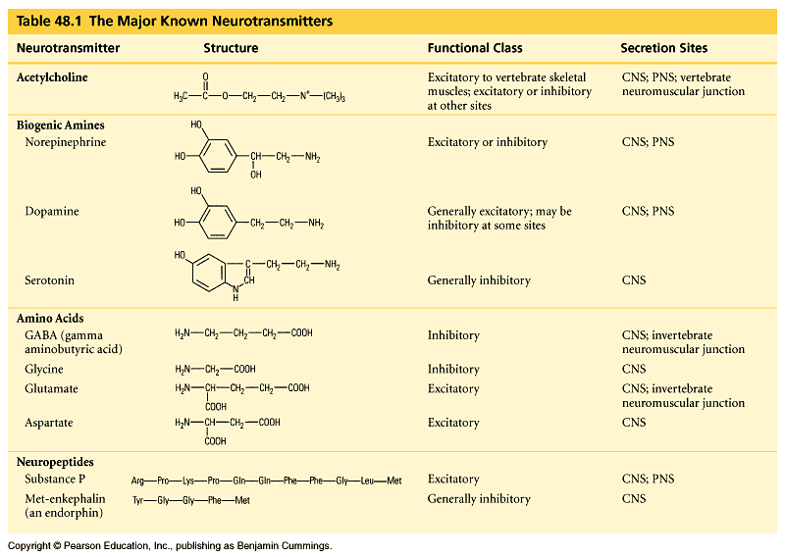
The Major Known Neurotransmitters

Slide 30
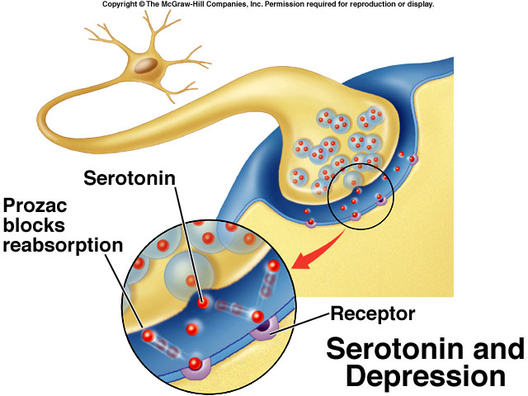
Notes:
Also LSD and mescaline

Slide 31
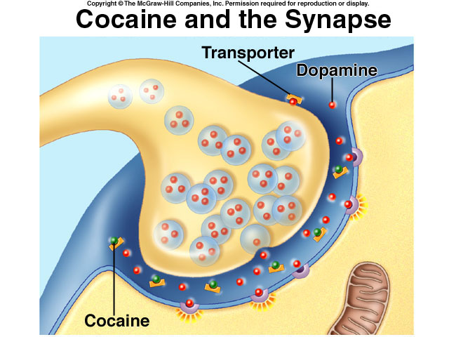

Slide 34
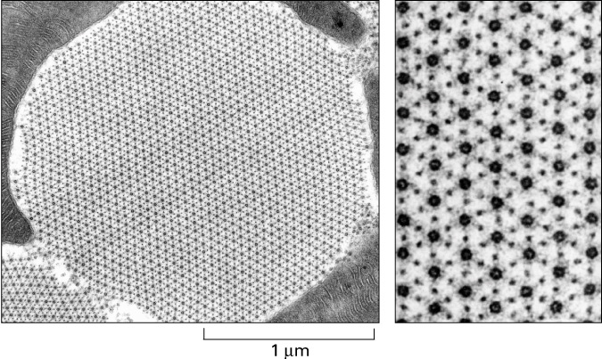
Chapter 49
Sensory Neurons and Muscles

Slide 35
Types of Sensory Neurons
Mechanoreceptors- detect physical deformations: pressure, touch, stretch, motion, and sound.
Stretch receptors-flexion or extension or muscles
Hair Cells-movement of fluids
Pain Receptors-pressure
Chemoreceptors-detect chemical changes in the body
Thermoreceptors-detect temperature changes

Slide 36
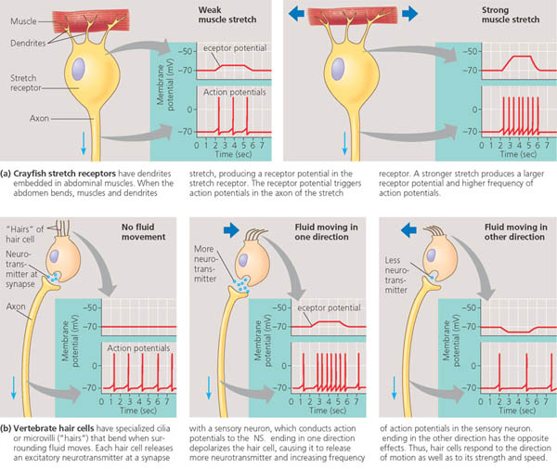
Types of Sensory Neurons: Stretch Receptors and Hair Cells

Slide 37
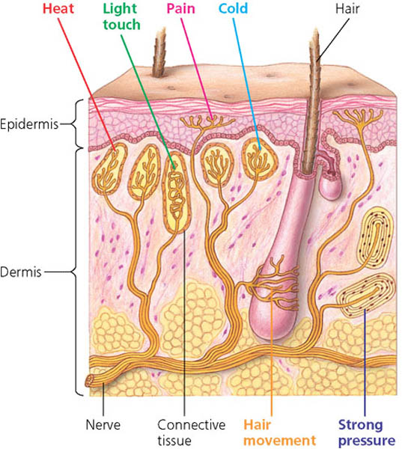
Sensory Neurons of the Skin

Slide 38
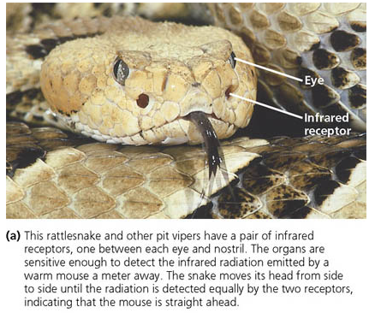
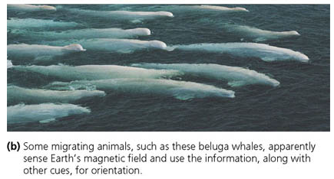
Other types of Sensory Neurons

Slide 39
Means of animal movement
Cilia
Flagellae
Muscles/Contractile cells

Slide 40
Vertebrate Muscle Types
Skeletal muscle
Striated
Voluntary
Smooth muscle
Non-striated
Involuntary
Cardiac muscle
Striated
Involuntary
Electrically coupled cells

Slide 41
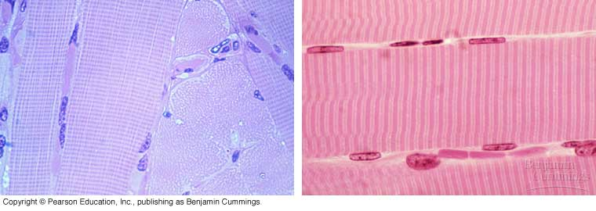
Skeletal Muscle
Many animals contain over 400 skeletal muscles
40-50% of total body weight
Functions of skeletal muscle
Locomotion and breathing
Postural support
Heat production

Slide 42
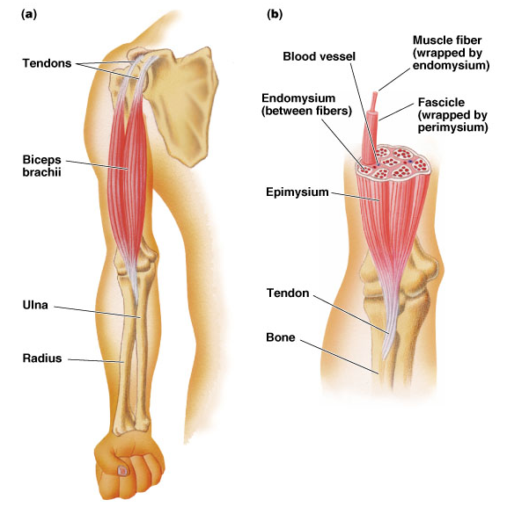
Structure of Skeletal Muscle: Connective Tissue Covering
Epimysium
Surrounds entire muscle
Perimysium
Surrounds bundles of muscle fibers (Fascicles)
Endomysium
Surrounds individual muscle fibers

Slide 43
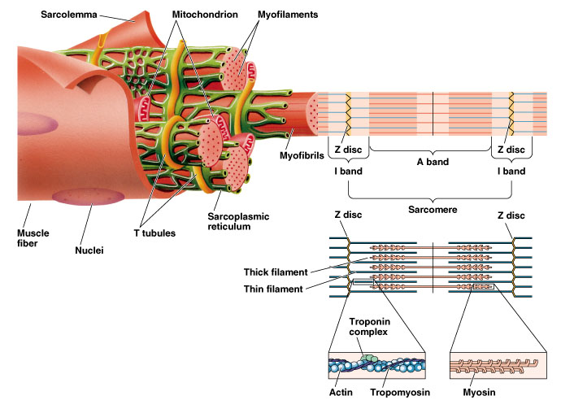
Structure of Skeletal Muscle: Microstructure
Sarcolemma
Muscle cell membrane
Myofibrils
Threadlike strands within muscle fibers
Actin (thin filament)
Troponin
Tropomyosin
Myosin (thick filament)
Notes:
Syncytium

Slide 44
Structure of Skeletal Muscle: Microstructure
A band
Anisotropic (dark)
I band
Isotropic (light)
Z disc
Zwischenscheibe (between zone)
α-actinin
H zone
Hellerscheibe (clear disc)

Slide 45
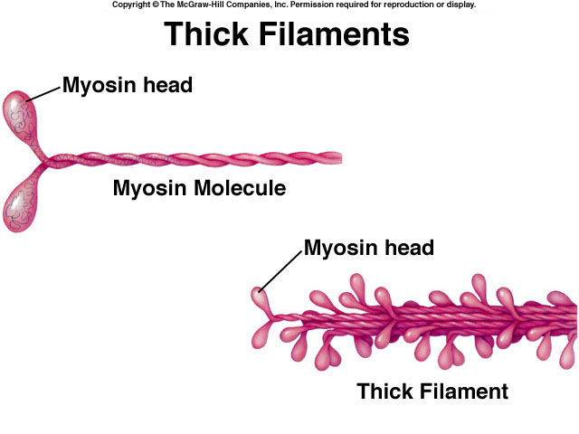

Slide 46
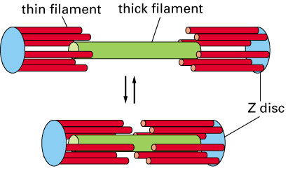
Muscular Contraction
The sliding filament model
Movement of actin filament over the myosin filament
Formation of cross-bridges between actin and myosin filaments
Reduction in the distance between Z-lines of the sarcomere

Slide 47
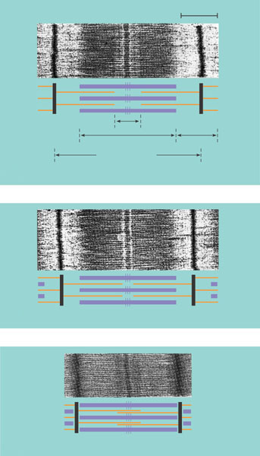
The sliding-filament model of muscle contraction
0.5 μm
(a) Relaxed muscle fiber. In a relaxed muscle fiber, the I bands and H zone are relatively wide.
Z
H
A
I
Sarcomere
(b) Contracting muscle fiber. During contraction, the thick and thin filaments slide past each other, reducing the width of the I bands and H zone and shortening the sarcomere.
(c) Fully contracted muscle fiber. In a fully contracted muscle fiber, the sarcomere is shorter still. The thin filaments overlap, eliminating the H zone. The I bands disappear as the ends of the thick filaments contact the Z lines.

Slide 49
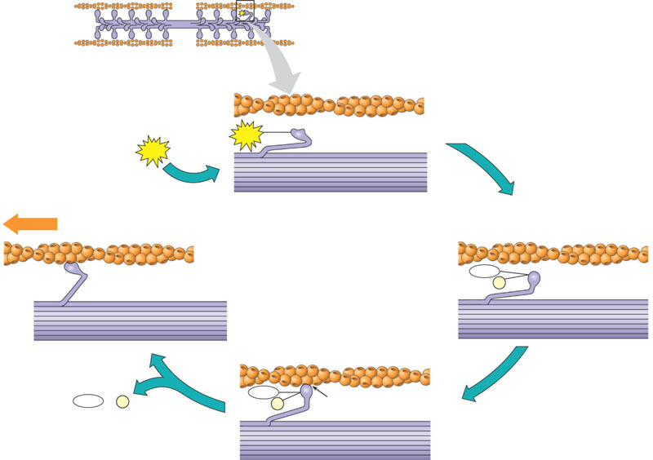
Myosin-actin interactions underlying muscle fiber contraction
Thick filament
1 Starting here, the myosin head is bound to ATP and is in its low-energy confinguration.
Thin filaments
5 Binding of a new mole-
cule of ATP releases the
myosin head from actin,
and a new cycle begins.
Thin filament
Myosin head (low- energy configuration)
1 The myosin head hydrolyzes ATP to ADP and inorganic phosphate ( _{i}) and is in its high-energy configuration.
ATP
2
ATP
P
Thick filament
Cross-bridge binding site
Thin filament moves toward center of sarcomere.
Actin
Myosin head (low- energy configuration)
Myosin head (high- energy configuration)
ADP
P _{i}
3
ADP
+
P _{i}
ADP
Cross-bridge
1 The myosin head binds to actin, forming a cross- bridge.
P _{i}
Releasing ADP and ( _{i}), myosin relaxes to its low-energy configuration, sliding the thin filament.
4
P

Slide 50
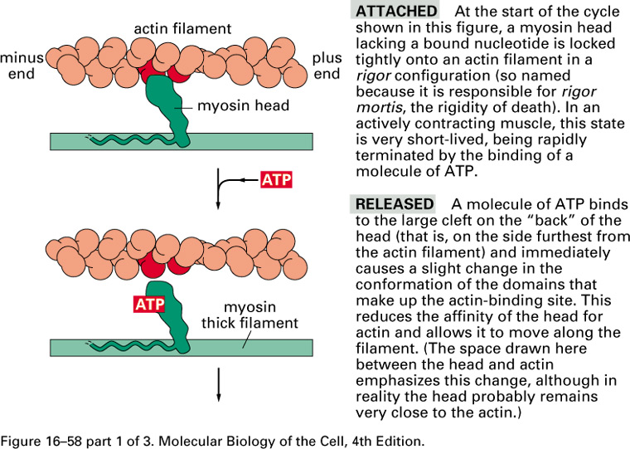

Slide 51
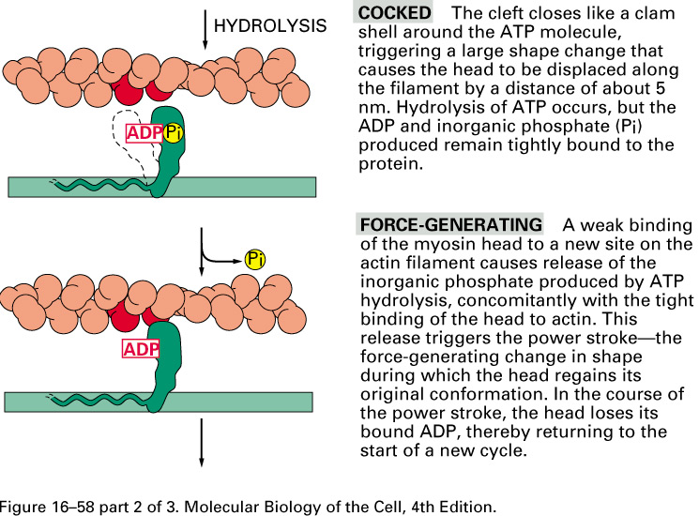
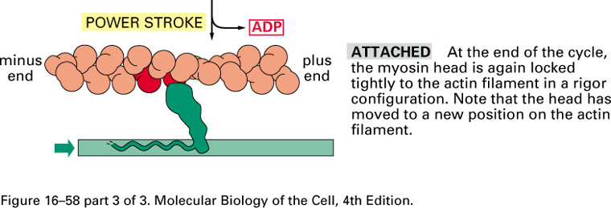

Slide 52
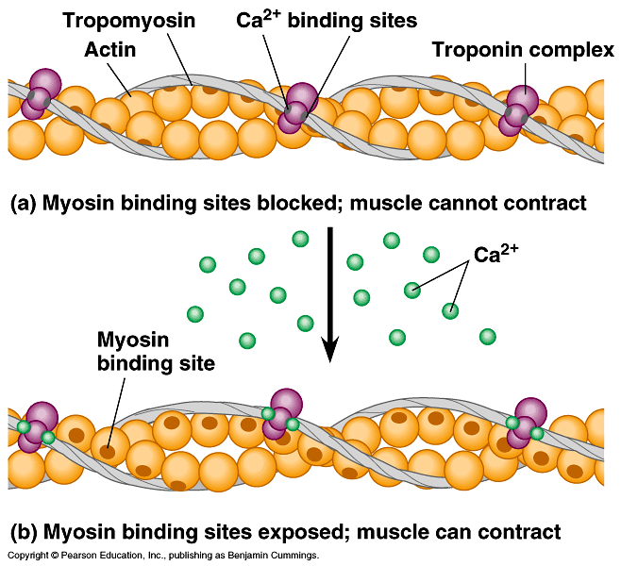
Hypothetical mechanism for the regulation of muscle contraction

Slide 53
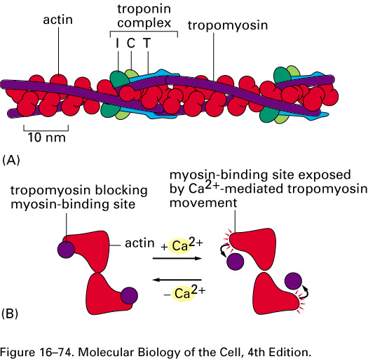

Slide 54
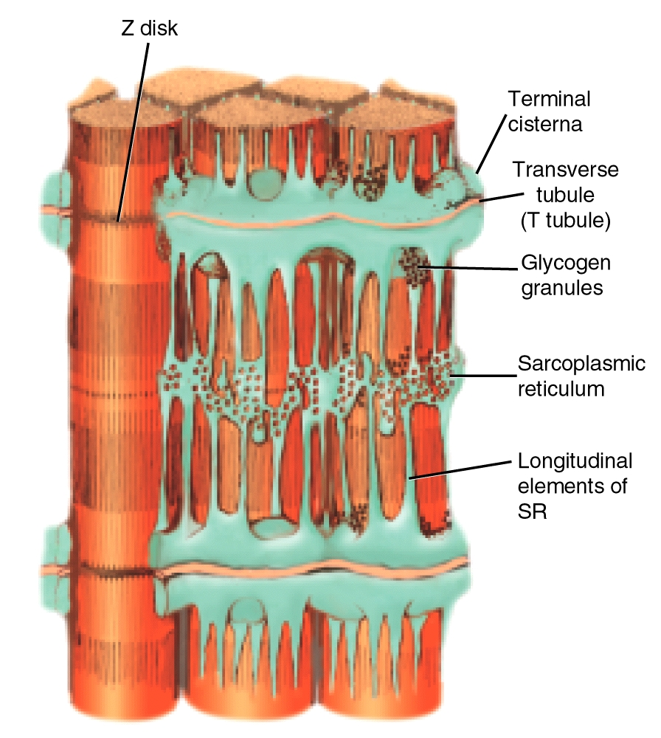
Sarcoplasmic Reticulum

Slide 55
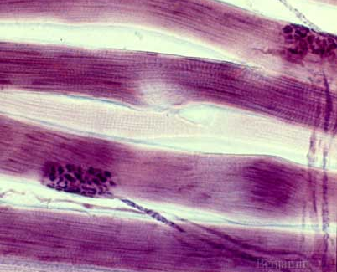
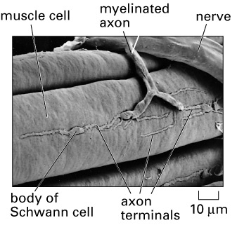
The Neuromuscular Junction
Site where motor neuron meets the muscle fiber
Separated by gap called the neuromuscular cleft
Motor end plate
Pocket formed around motor neuron by sarcolemma
Acetylcholine is released from the motor neuron
Causes an end-plate potential (EPP)
Depolarization of muscle fiber

Slide 56
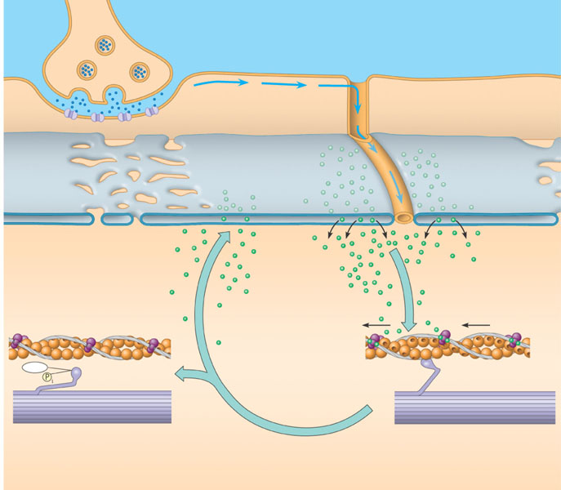
Review of contraction in a skeletal muscle fiber
Synaptic terminal of motor neuron
1
Acetylcholine (ACh) released by synaptic terminal diffuses across synaptic cleft and binds to receptor proteins on muscle fiber’s plasma membrane, triggering an action potential in muscle fiber.
Synaptic cleft
T TUBULE
PLASMA MEMBRANE
2
Action potential is propa-
gated along plasma
membrane and down
T tubules.
ACh
SR
3
Action potential
triggers Ca²⁺
release from sarco-
plasmic reticulum
(SR).
Ca²⁺
7
Tropomyosin blockage of myosin-
binding sites is restored; contraction
ends, and muscle fiber relaxes.
4
Calcium ions bind to troponin;
troponin changes shape,
removing blocking action
of tropomyosin; myosin-binding
sites exposed.
Ca²⁺
CYTOSOL
6
Cytosolic Ca²⁺ is
removed by active
transport into
SR after action
potential ends.
ADP
P₂
5
Myosin cross-bridges alternately attach
to actin and detach, pulling actin
filaments toward center of sarcomere;
ATP powers sliding of filaments.

Slide 57
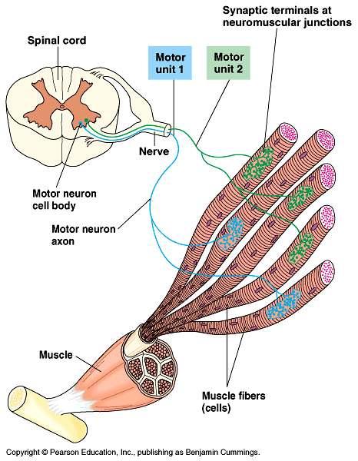
Motor units in a vertebrate muscle

Slide 58
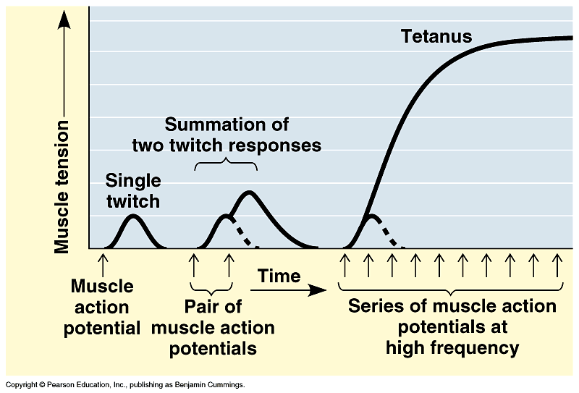
Temporal summation of muscle cell contractions

Slide 59
Fiber Types and athletic performance
Type I- Slow
Type II-Fast

Slide 60
The interaction of muscles and skeletons in movement
Human
Grasshopper
Extensor muscle relaxes
Biceps contracts
Tibia flexes
Flexor muscle contracts
Triceps relaxes
Forearm flexes
Extensor muscle contracts
Tibia extends
Biceps relaxes
Forearm extends
Flexor muscle relaxes
Triceps
contracts

Slide 61
Vertebrate Muscle Types
Skeletal muscle
Striated
Voluntary
Smooth muscle
Non-striated
Involuntary
Cardiac muscle
Striated
Involuntary
Electrically coupled cells

Slide 62
Muscle Contraction

