Slide 1
House Styles
Architecture one

Slide 2
The different styles of houses
Cape Cod
Cape Ann
New England Gambrel
Garrison
Salt Box
Southern Colonial
Contemporary
Ranch

Slide 3
Cape Cod
Normally built as one story or one and one half story.
Windows have shutters, used for protection from the stormy winds, but now used for aesthetics
Steep gable roof lines, with little overhang
Eaves are very close to tops of the window sill

Slide 4
Steep Gable Roof
Shuttered windows
Little overhang, eave line close to top of window

Slide 5
Cape Ann
Similar to Cape Cod house style, but the chimneys are larger and located towards the center of the roof
The Cape Ann also has a tapering gambrel roof

Slide 6
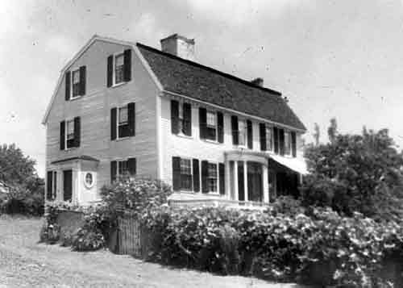
Large, centered Chimney
Tapered Gambrel roof

Slide 7
New England Gambrel
House style that has a gambrel roof, where the pitch changes drastically between the ridge and eaves.
Ridge- The topmost part of the roof
Eaves- The overhang of the roof
Pitch- The steepness of the roof, from ridge to eave

Slide 8
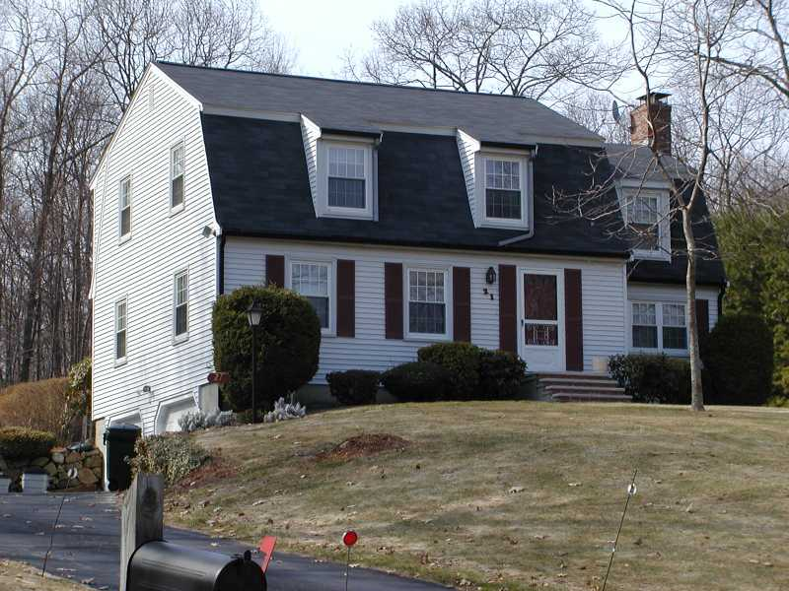
Ridge
Eave
Change in pitch

Slide 9
Garrison
The Garrison style is a two story house
The second story overhangs the first story
Gable style roof

Slide 10
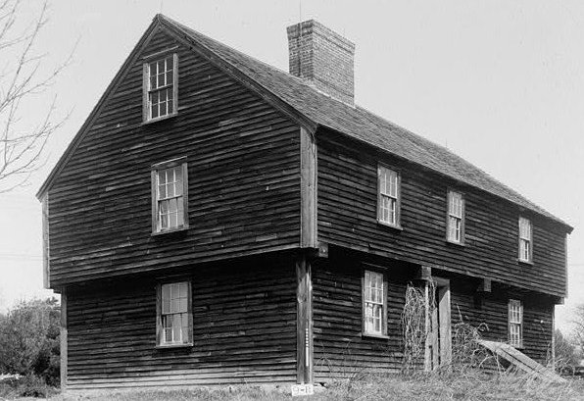
Gable Style
Roof
2nd story overhangs first

Slide 11
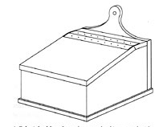
Salt Box
Unique gently sloped roof, where the rear extends to the first story
The low roof helps to combat the bitter winds, common in New England.
It receives its name from the boxes used to store salt, tea, and coffee during the colonial period.

Slide 12
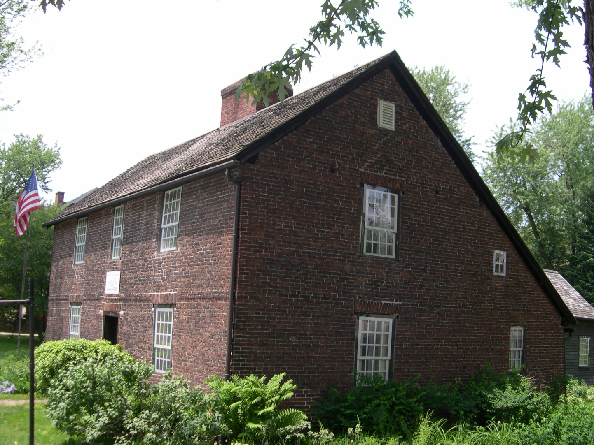
One story in the rear of the house, two stories in the front
Roof goes to 1st story in the rear

Slide 13
Southern Colonial
These large houses are two or three stories
A series of columns extend the roof out to the front, covering the front porch.
The southern colonial is also known for its extensive use of molding on the interior and exterior

Slide 14
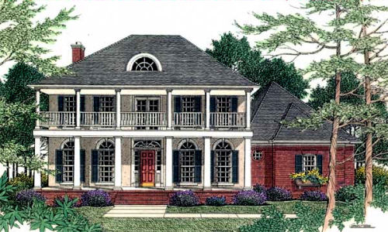
Colonnade extends to create a porch, and extends roof

Slide 15
Contemporary
Known for drastic geometric design features, irregular angles, and unorthodox use of building material
There was no set pattern and shape, and many times focused on the surroundings and materials being used.
Another characteristic of contemporary is its generous use of glass.

Slide 16
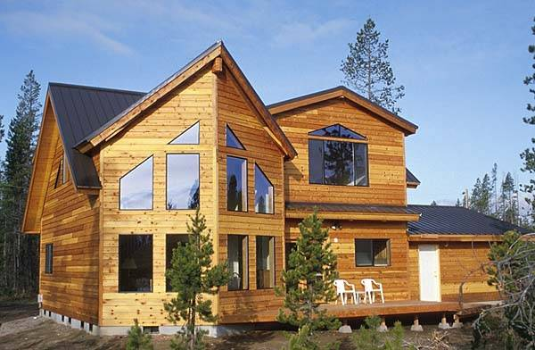
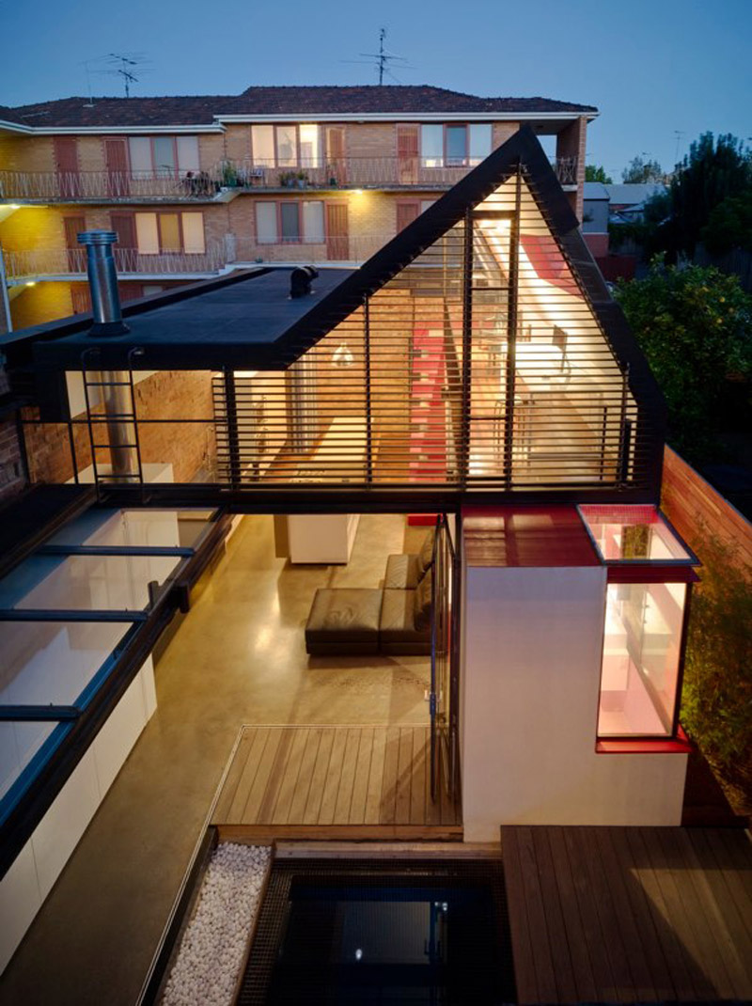
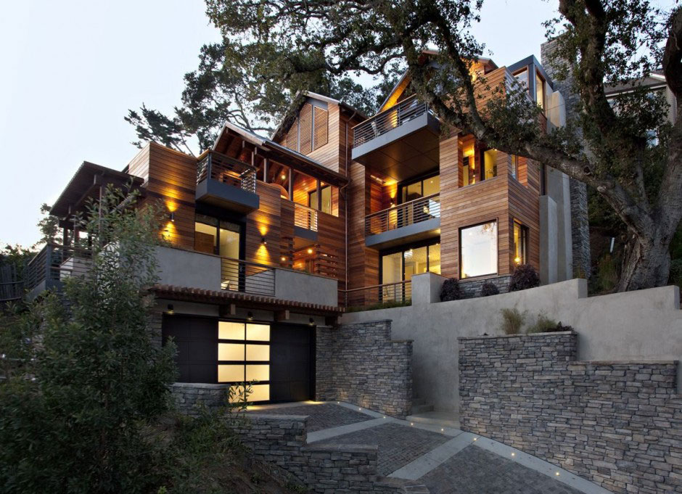

Slide 17
Ranch
One story house
Low pitch gable roof with long overhangs
Can be L-shaped to break up the long line.
Built on a concrete slab
Revival movement added skylights and cathedral ceilings to modern ranch houses.

Slide 18
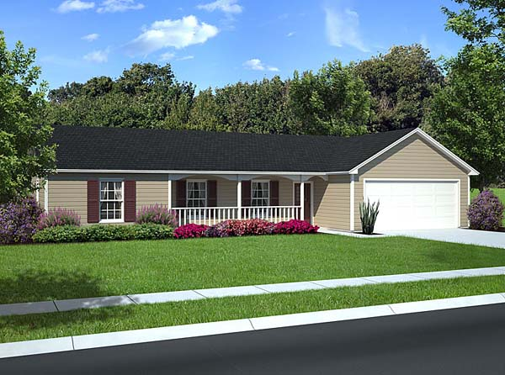
L-shaped to break up long line
Low pitch Gable roof with overhang
One story house

