Slide 1
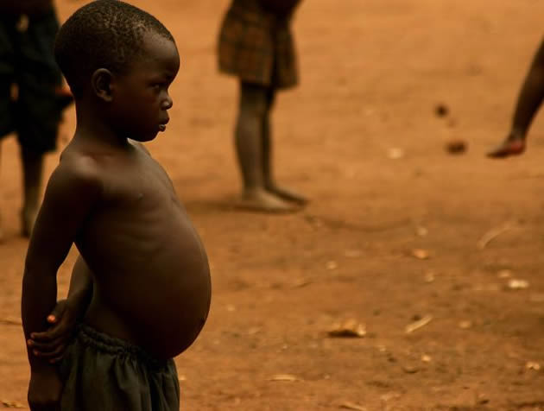
Kwashiorkor
Severe form of malnutrition (inadequate calorie/protein intake)
Most common in impoverished and developing countries
All cells in your body contain protein
protein in your diet helps repair and make new cells
Symptoms
Delayed growth in children
Swollen belly
Frequent infections
Signs
Malnutrition
Fatigue
Loss of appetite
Thirst
Bloating
Diarrhea
Treatment
High protein diet
Breastfeeding

Slide 2
Scurvy
Stacie & Kayla

Slide 3
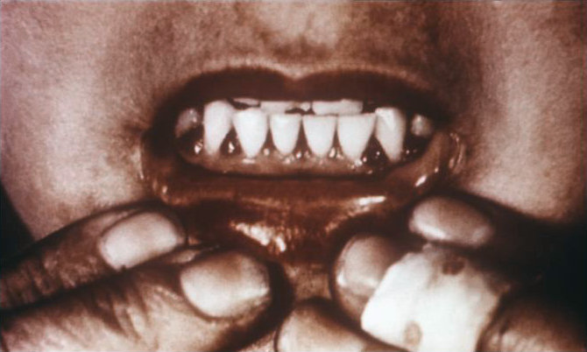
-most common in the elderly of developed countries
-some symptoms are fatigue, spots on the skin, spongy gums, bleeding from mucous membranes, pale skin, depression.
- this disease is caused by the lack of vitamin C is a person's diet

Slide 4
it can affect anybody especially the elderly who are unable to have a healthy diet.
the parts of the body that are affected are the gums as well as the skin, there is a bumpy rash that can appear on the skin in places such as the neck, legs, and arms.
the cure for this disease is to eat a vitamin c rich diet, and the symptoms will go away in less that two weeks.

Slide 5
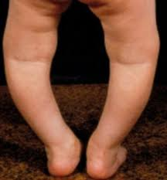
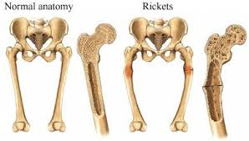
Rickets
A softening and weakening of bones in children, usually due to inadequate vitamin D.

Slide 6
Rickets is commonly found in India, The Middle East, and Africa
Rickets is common in young children aged 6-24 months, and is caused by a Calcium, Phosphate, of Vitamin D deficiency.
Signs - Dental deformities, Delayed formation of teeth, impaired growth, skeletal deformities (most commonly bowlegs), Involuntary muscle contractions, seizures.
Symptoms - Bone pain, tenderness, decreased muscle strength.

Slide 7
Rickets most commonly affects the legs, giving them a bowed appearance, but can also affect the skull, spine, and the ribcage.
Rickets can be cured if the problem is resolved before any permanent damage is done to the bone structure. This usually includes increasing a child’s vitamin D and calcium intake.
The treatment is to increase vitamin D and calcium intake, or possibly surgery if the bone structure has been compromised.

Slide 8
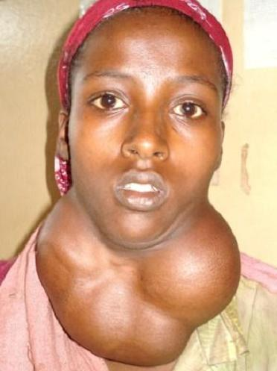
Goiter
Alexandra Millett and Wyatt Colangelo

Slide 9
Who it affects/Parts of Body Affected
Usually more common in women but still occurs in men
Affects the thyroid gland (Large growth)

Slide 10
Treatment and Cures
Use radioactive iodine to shrink the enlarged thyroid gland
Take thyroid hormone replacements such as Synthroid and Levothroid
Consider surgery to remove the goiter
Increase iodine intake

Slide 11
Symptoms/Signs
Visible swelling the base of your neck, may be very obvious when you shave or put on make up
Tight feeling in your throat
Coughing
Hoarseness
Difficulty swallowing
Difficulty breathing

Slide 12
Causes
A lack of dietary iodine
A goiter can sometimes occur when your thyroid gland produces too much thyroid hormone (hyperthyroidism)
Can also occur from a lack of thyroid hormones (hypothyroidism)
Could come from Thyroid cancer or tumors/diseases

Slide 13
Where it is found
Goiters can be found in less developed countries where they lack iodine in their diet

Slide 14
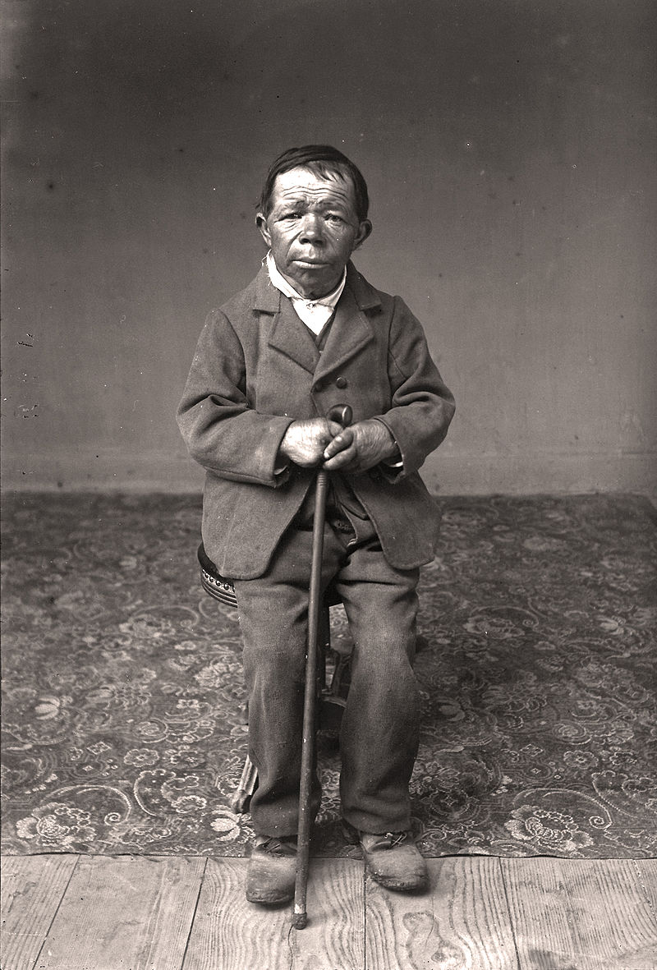
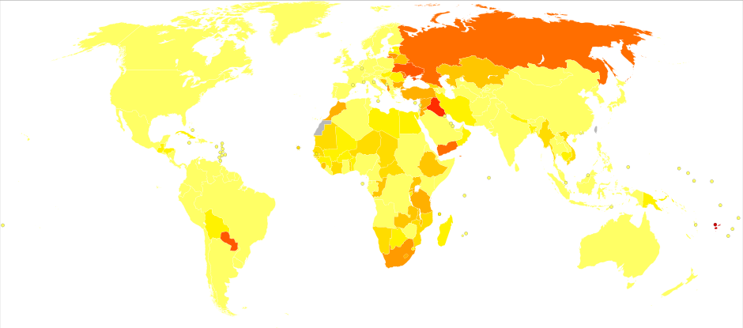
Cretinism
Cretinism is a condition of stunted physical and mental growth due to untreated congenital deficiency of thyroid hormones.
Most common in the 1800s and early 1900s. Caused by a lack of iodine and by foods with poor nutrients, and is more common in poorer social classes, farmers, and sailors and in less developed countries.

Slide 15
Cretinism
Signs / Symptoms:
Growth failure, thick or dry skin, protruding abdomen, bone dystrophy,
delayed physical and mental growth
Parts of the Body Affected:
Overall body size, bone, skin, general growth, thyroid
You can be born with hypothyroidism which causes Cretinism.
Treatment:
Can be prevented by consuming a varied diet that is rich in nutrients . Eating recommended amounts of iodine can help lessen the symptoms / effects.

Slide 16
Defective Blood Clotting

Slide 17
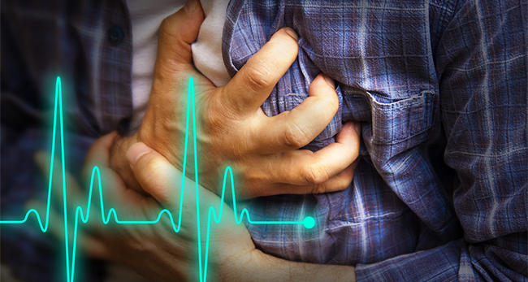

Slide 18
Symptoms and Signs
Vitamin K deficiency results in impaired blood clotting, usually demonstrated by laboratory tests that measure clotting time.
Symptoms include:
Easy bruising and bleeding
Nosebleeds
Bleeding gums
Blood in the urine
In infants, vitamin K deficiency may result in life threatening bleeding within the skull.

Slide 19
Cause of Bleeding Disorders
The most likely cause of a bleeding disorder is a failure of the blood to clot. There are many conditions that can affect the way blood clots. These causes are linked to defects in the proteins of blood plasma, which are directly responsible for the coagulation of blood. In some bleeding disorders, these proteins may be completely eradicated or extremely low in number. A majority of bleeding disorders are also hereditary. Other conditions that cause bleeding disorders are:
Liver disease
Low red blood cell count
Vitamin K deficiency
Side effects of medication

Slide 20
Parts of the Body Affected
Bleeding disorders do not affect specific parts of the body, however the most common areas where bleeding disorders affect are the joints, mouth, nose, throat, brain, and heart. Clots occur in veins or arteries.

Slide 21
Who it affects
Affects mostly men, because it occurs in the X chromosome
Genetic

Slide 22
Treatment and Cures
Iron Supplementation- If significant blood loss occurs, a doctor may prescribe iron supplements to replenish the amount of iron in the body.
Blood Transfusion- A blood transfusion replaces the lost blood with blood taken from a donor.

Slide 23
Obesity

Slide 24
Places it is common
United States of America is the most obese country. However more than 2 billion people around the world are overweight/obese - Nearly 30% of the world population.

Slide 25
Symptoms/Signs
Some of the signs of overweight or obesity include:
Clothes feeling tight and needing a larger size.
The scale showing that you've gained weight.
Having extra fat around the waist.
A higher than normal body mass index and waist circumference.

Slide 26
Cause
Genetics. A person is more likely to develop obesity if one or both parents are obese. ...
Overeating. Overeating leads to weight gain, especially if the diet is high in fat. ...
A diet high in simple carbohydrates. ...
Frequency of eating. ...
Slow metabolism. ...
Physical inactivity. ...
Medications. ...
Psychological factors.

Slide 27
Who it affects
More than 35% of U.S. adults are obese,¹ and more than 34% are overweight. Obesity affects 17% of all children and adolescents in the United States, which is three times the prevalence from just one generation ago. Nearly 32% of children and adolescents are either overweight or obese.

Slide 28
Parts of the body affected
Obesity doesn’t just add layers of fat around your thighs and torso. Some of the greatest consequences of poor diet and lack of exercise occur inside your body, out of sight and too often out of mind. We can’t see these health effects, we think, so they must not exist.
Your Heart
Your Colon
Your Brain
Your Skin
Your Lungs

Slide 29
Cure? How?
Improve Nutrition
Physical Activity
Behavior Modification-Start therapy sessions. Therapists can work with you on behavioral and emotional issues that relate to eating. A therapist can teach you to cope with food cravings and anxiety that may lead to overeating.
Medication
Surgery

Slide 30
Treatment
For Adults
Try to lose 5 to 10 percent of your current weight over 6 months. This will lower your risk for coronary heart disease (CHD) and other conditions.
The best way to lose weight is slowly. A weight loss of 1 to 2 pounds a week is do-able, safe, and will help you keep off the weight. It also will give you the time to make new, healthy lifestyle changes.
If you've lost 10 percent of your body weight, have kept it off for 6 months, and are still overweight or obese, you may want to consider further weight loss.

Slide 31
Treatment
For Children and Teens
If your child is overweight or at risk for overweight or obesity, the goal is to maintain his or her current weight and to focus on eating healthy and being physically active. This should be part of a family effort to make lifestyle changes.
If your child is overweight or obese and has a health condition related to overweight or obesity, your doctor may refer you to a pediatric obesity treatment center.

Slide 32
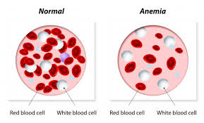
Anemia

Slide 33
What It is
Definition: a condition marked by a deficiency of red blood cells or of hemoglobin in the blood, resulting in pallor and weariness.
SYMPTOMS AND SIGNS
fatigue and loss of energy
Unusually rapid heart beat, particularly with exercise
Shortness of breath and headache, particularly with exercise
Difficulty concentrating
Dizziness
Pale skin
Leg cramps
Insomnia

Slide 34
Cause and who it affects
Caused by lack of healthy red blood cells
Anemia Caused by Vitamin B12 Deficiency
WHO DOES ANEMIA AFFECT
Men, women, and children of all races but it is most common in childbearing women.
Anemia can be hereditary
It is common during pregnancy
It can be a result of poor diet

Slide 35
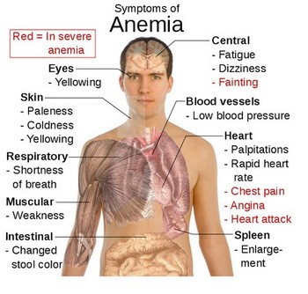
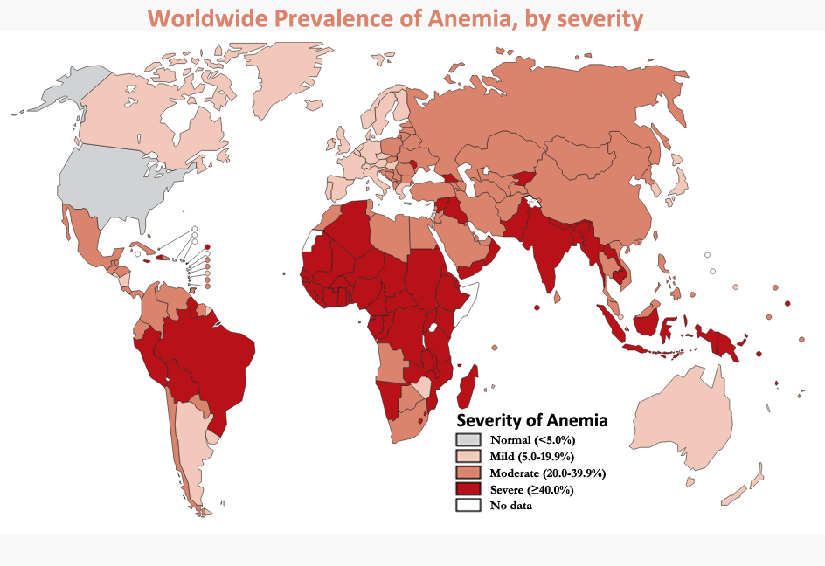

Slide 36
treatment and cure
Iron supplements may be used for iron deficiency.
Vitamin B supplements may be used for low vitamin levels.
Blood transfusions may be used for blood loss.
Medications to induce blood formation may be used if the body’s blood production is reduced.

Slide 37
Disease: Pellagra
A disease that occurs when a person is lacking or cannot absorb niacin or tryptophan. Also known as vitamin B3 or nicotinic acid, niacin is one of eight B vitamins. Like all B Vitamins, niacin plays a role in converting carbohydrates into glucose, metabolizing fats and proteins, and keeping the nervous system working properly. Niacin also helps the body make sex- and stress-related hormones and improves circulation and cholesterol levels.
Tryptophan is one of the amino acids that makes up protein. Your liver can convert tryptophan from high-protein foods like meats and milk into niacin.
Matt Stagnitta & Joey LaVake
1A

Slide 38
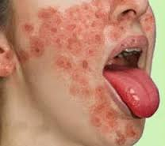
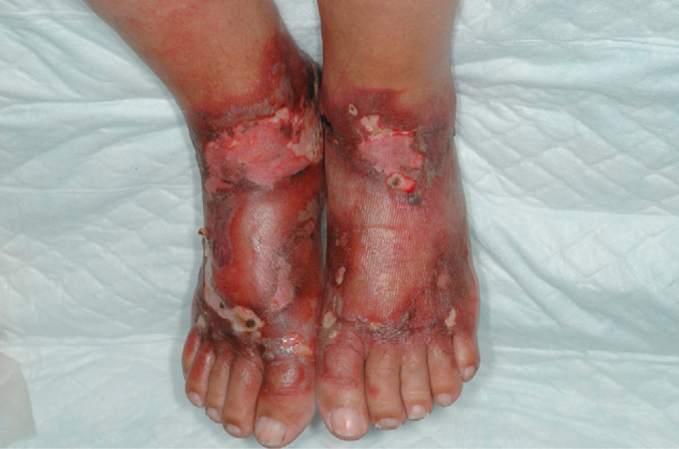
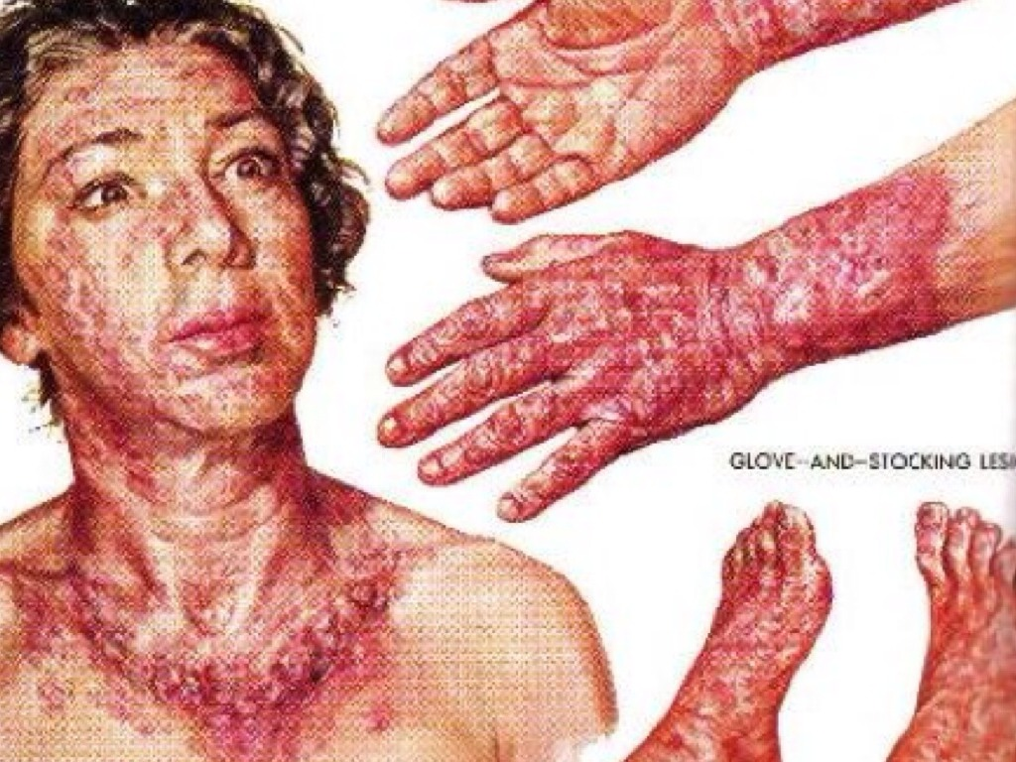
Symptoms/Signs
Symptoms of mild niacin deficiency include:
indigestion
fatigue
canker sores
vomiting
depression
depression
disorientation
memory loss
Severe deficiency, called pellagra, can cause symptoms related to the skin, digestive system, and nervous system. They include:
thick, scaly pigmented rash on skin exposed to sunlight
swollen mouth and bright red tongue
Vomiting and diarrhea
headache
apathy
fatigue
If not treated, pellagra can lead to death.

Slide 39
Cause/What gets affected
Lack of Niacin (vitamin B3) and tryptophan (amino acid, found in meat, fish, eggs, peanuts, and poultry) in the diet
Niacin deficiency is more likely to be caused by problems that affect absorption of niacin or tryptophan. The most common cause is alcoholism. Other possible causes include disorders of the digestive system and prolonged treatment with the tuberculosis drug isoniazid
Hands, feet, chest, neck, face
Cure/Treatments
Prevention: The recommended daily allowance (RDA) for niacin is 16 milligrams per day for men and 14 milligrams per day for women. Good sources of niacin include red meat, fish, poultry, fortified breads and cereals, and enriched pasta and peanuts.
Treatments: If you don't eat a lot of niacin-rich foods or if you have a medical condition that affects the absorption of niacin or tryptophan, speak to your doctor. Niacin supplements or multivitamin/mineral supplements, which usually contain at least 20 milligrams of niacin, can help prevent niacin deficiency. Supplements of niacin such as nicotinic acid or nicotinamide are approved by the FDA for treating niacin deficiency. Under the supervision of a doctor, high doses of over-the-counter or prescription niacin or nicotinic acid can be used to treat high cholesterol, including high triglycerides. However, too much nicotinic acid or niacin can be harmful. Avoid taking more than your doctor prescribes or recommends. If you are taking doses of more than 100 milligrams per day, doctors recommend periodic liver function tests.

Slide 40
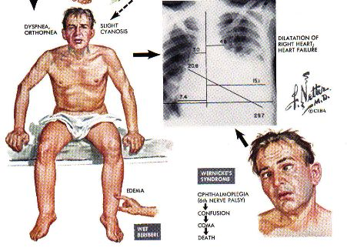
Beriberi
by Ileena Irving and Kevin Doo

Slide 41
Beriberi is the lack of thiamine (vitamin B1) in the body
Dry Beriberi:
Difficulty walking
Loss of feeling in hands and feet
Loss of muscle function in the lower legs
mental confusion/speech difficulty
pain / tingling/ vomiting
strange eye movements
Wet Beriberi:
Awaking at night with shortness of breath
Increased heart rate
Shortness of breath with activity
Swelling of the lower legs
Genetic Beriberi
same
Wet and Dry Beriberi usually occur in the same patient with one set of symptoms predominating

Slide 42
Is not common in US due to vitamin enriched foods
25% of Alcoholics in the US have symptoms of beriberi
Common in less developed countries (southeast Asia)
Affects the cardiovascular system, nervous system, muscular system, digestive system
To treat beriberi, inject/ingest vitamin B1 (thiamine)
If untreated, beriberi can be deadly
If treated in the early stages, most symptoms will improve quickly
Can be treated but may cause lasting damage to nervous system and cardiovascular system

Slide 43
Marasmus
by Vincent M and Jake Y

Slide 44
What is Marasmus
A rapid deterioration in nutritional status in a short time can lead to marasmus, one form of acute malnutrition.
It is characterised by severe wasting of fat and muscle which the body breaks down to make energy.
CHARACTERISTICS
‘skin and bones’ appearance
ribs easily seen, skin is loose

Slide 45
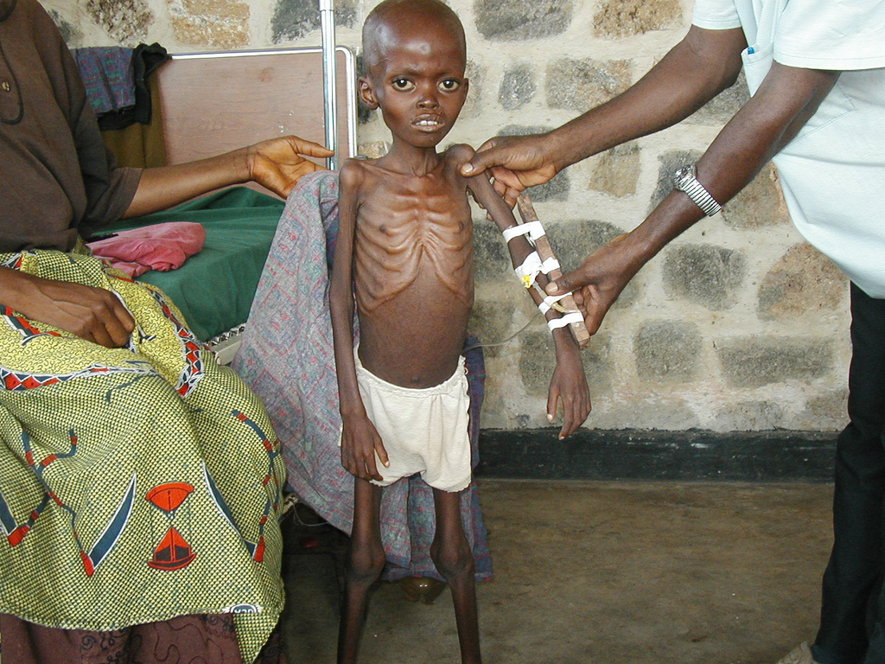
What does it affect
Lack of nutrients leads to the immune system to stop working
Organs can fail due to lack of nutrients
Can lead to permanent vision loss

Slide 46
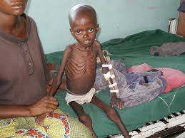
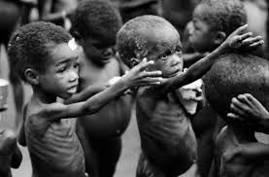
Treatment
The best way to treat Marasmus is to give the affected individual a healthy and nutritious diet which is rich in proteins and calories so that the body gets sufficient energy to function.

Slide 47
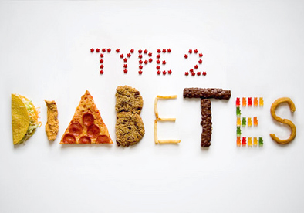
Diabetes (type 2)
By: Adrian Angon-Bravo

Slide 48
General info
Having type 2 diabetes means your pancreas can’t make enough insulin to keep your blood glucose at normal levels
Most common type of diabetes
Some groups are higher at risk to developing than others; African Americans, Latinos, Native Americans, Asian American/Pacific Islanders
Primarily affects the pancreas which then cause affect other parts afterward
Can be caused by many factors

Slide 49
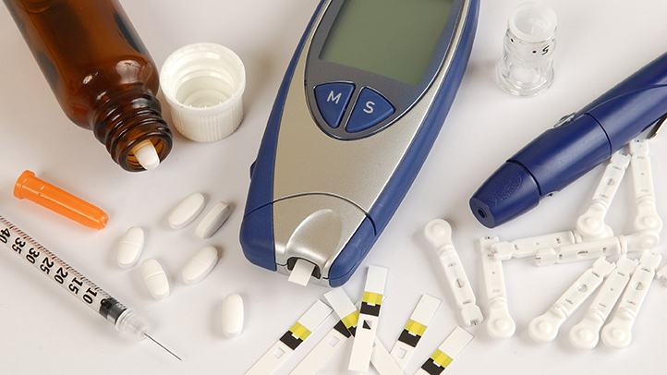
Not curable, but treatable

Slide 50
Symptoms/Signs
Increased thirst and frequent urination
Increased hunger
Weight loss
Fatigue
Blurred vision
Slow healing sores and frequent infections
Areas of darkened skin

Slide 51
Xerophthaimia
Jenny and Gabriella

Slide 52
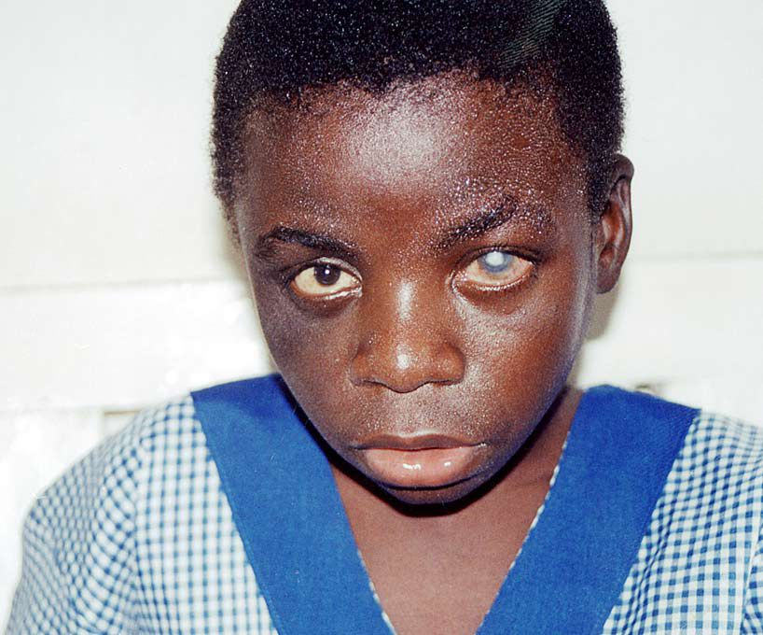
What is it?
Abnormal dryness of the conjunctiva and cornea of the eye, with inflammation and ridge formation, typically associated with vitamin A deficiency.

Slide 53
Where it’s common
Affects people worldwide
More common in developing countries such as parts of Africa and the South Pacific
Common in infants and elderly people

Slide 54
Signs/Symptoms
Irritation in the eye
Dryness of the cornea
Night blindness
Increased sensitivity to direct light
Can cause complete blindness in extreme cases

Slide 55
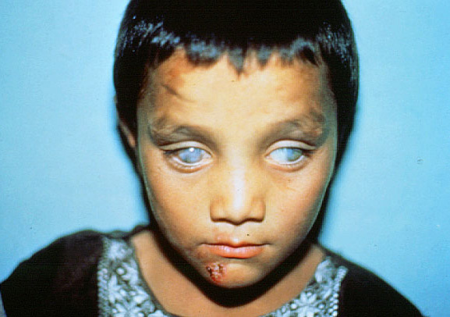
Causes
-Deficiency in Vitamin A
-Autoimmune Diseases
-Past injuries
-Getting older
-Disorders of the Endocrine system
-Chemical or thermal burns
-Regular intake of drugs

Slide 56
Treatment
Increase the amount of your vitamin A intake.
Application of certain topical antibiotics to prevent bacterial infections.
Wear dark sunglasses when outdoors to prevent direct contact with sunlight.
Sleep with a humidifier to aleviate excessive dryness.

