Slide 1
Genetic Modification of Food

Slide 2
The Rise of GMOs
In the 1980’s and 1990’s with major advances in the field of genetics, scientists were able to create crops and livestock that was more efficiently grown and more nutritious while lessening the impact of agriculture on our environment. However with this rise of GMOs came the rise of controversy from consumers, small farmers, opponents of big business and environmental activists as the risks are not well understood. In addition, some nations are refusing imports of products that have been genetically engineered.

Slide 3
Terms to Know
Genetic Engineering: A process whereby scientists directly manipulate an organsim’s genetic material in the lab, by adding, deleting, or changing segments of its DNA.
Genetically modified organisms (GMOs): Organisms that have been genetically engineered using a technique called recombinant DNA technology.
Recombinant DNA: DNA that has been patched together from the DNA of multiple organisms. Scientists break up DNA from organisms and then patch them back together, trying to place genes that produce certain proteins and code for certain desirable traits into the genomes of organisms lacking those traits.
Transgenic: An organism that contains DNA from another species

Slide 4
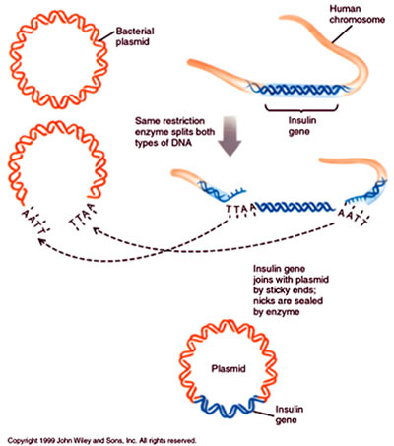

Slide 5
The old and the new…
Genetic alteration of food products is not a new process. For thousands of years, farmers used selective breeding by preferentially mating individuals with favorable characteristics. These characteristics included size of produce, resistance to disease, faster growing time, etc.
Proponents for GM crops say this process is no different than what has been going on for thousands of years, and there is nothing to make anyone believe that the GM foods will be less safe than non-GM foods
Critics say that GM foods are different than selective breeding foods as genes of different species are being mixed together, being done in labs rather than with whole organisms in the field, and that combinations of genes are coming together unnaturally.

Slide 6
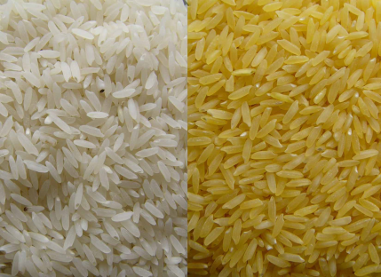
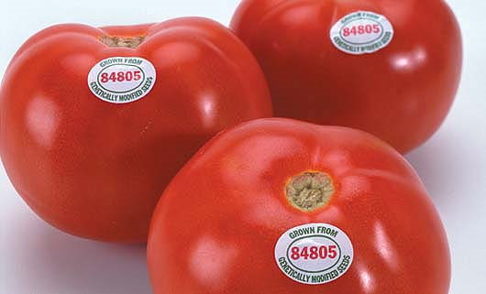
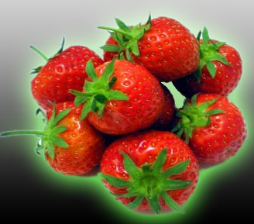
Some examples of GM foods
Golden Rice: Includes vitamin A. Genes taken from a plant with vitamin A were spliced into the rice genome
FlavrSavr Tomato: Tastes better, stays firmer during shipping, and lasts longer in the produce department.
Ice-minus strawberries: An anti-freeze like substance created from a bacteria was sprayed on strawberries, preventing them from freezing during early frosts.

Slide 7
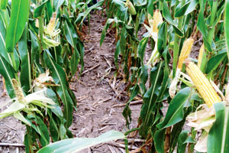
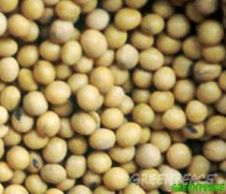
Bt crops and Starlink Corn: Crops created to produce their own pesticide from a bacterial gene. 18 crops have been created, including Starlink corn that was approved to be used as animal feed.
The herbicide known as Roundup kills weeds but also kills crops. Roundup ready crops are immune to the effects of the herbicide.
Terminator seeds: Plants are able to kill their own seeds, ensuring that a farmer must buy new seeds every year.

Slide 8
Biotechnology and our future of food
In the last 40 years, we have become dependent on GM foods. 2/3 of the US soybeans, corn, and cotton are genetically modified. Worldwide as of 2002, approx. 145 million acres of GM crops were planted, encompassing 5-6 million farmers in 16 countries. The US, Argentina, Canada and China account for 99% of this land and farmers. Because these countries are major exporters, many countries throughout the world are relying on crops that are genetically modified. The numbers are farmers and countries allowing GM crops has jumped 10% each year.
As GM food products have expanded, the controversy surrounding them has increased as well. Scientists, citizens and politicians have all become increasing concerned that the food may not be safe, that the transgenes could escape and pollute ecosystems and damage non-target organisms, that the pests would evolve resistance, and that they may ruin the integrity of native ancestral species.

Slide 9
Science and Research with GMOs
Three studies in Britain in 2003:
GM crops could produce long term financial benefits, though short term benefits are small.
Little to no evidence of harm to human health but noted that effects on wildlife and ecosystems should be tested before crops are approved or used.
GM fields support less biodiversity with beets and oilseed, but more biodiversity with corn fields. This was due to herbicide use.
Overall results indicated that impact of GM crops are complex and will vary with the conditions under which the crops are grown.

Slide 10
More than just science
Is it okay that we “tinker” with the food supply?
Are we changing what is natural?
Are we losing control over our food since we cannot have the option not to eat?
Will this lead to a domination or monopoly of a few large corporations who have undertaken the science of GM foods and leave the small farmer to vanish?
The future of GM foods seems likely to hinge on social, economic, legal, and political factors as well as scientific ones.
So which side will win the battle?

